Slide 1
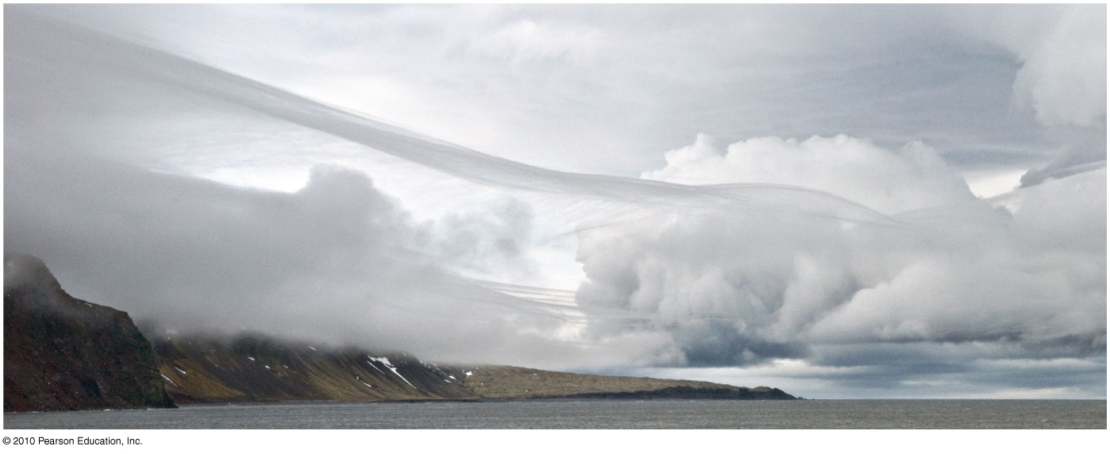
ATMOSPHERIC WATER AND WEATHER
CHAPTER 5

Slide 2
Atmospheric Water and Weather
Water on Earth: Location and Properties
Humidity
Atmospheric Stability
Clouds and Fog
Air Masses
Atmospheric Lifting Mechanisms
Midlatitude Cyclonic Systems
Violent Weather

Slide 3
Worldwide Equilibrium
Earth’s water quantity achieved its present volume – 2 bya
Remained constant since then
Water is lost from the system escaping to space or breaking down and forming new compounds
This lost water is replaced by pristine water, which emerges from the earth by outgassing
Even with this net balance in quantity, there has been world wide changes in sea-level - eustasy

Slide 4
Distribution of Earth’s Water
Most of Earth’s land - Northern Hemisphere
Water dominates in the Southern Hemisphere
Earth has a distinct oceanic hemisphere and a distinct land hemisphere
Present location of all earth’s liquid and frozen water:
Oceans contain 97.22%
Freshwater – 2.78%
22% - groundwater & soil moisture
The greatest repository is in glaciers and ice sheets
< 1% - lakes, rivers, streams

Slide 5
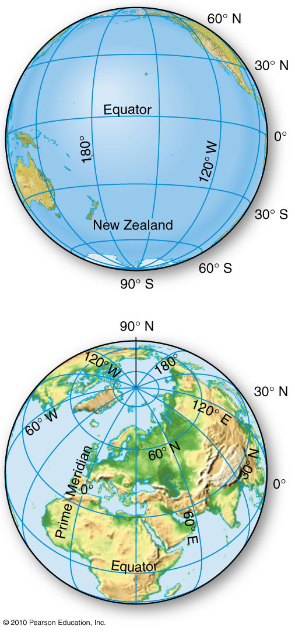
Land and Water Hemispheres
Figure 5.2
Christopherson, Elemental Geosystems, Sixth Edition
Copyright © 2010 Pearson Education, Inc.

Slide 6
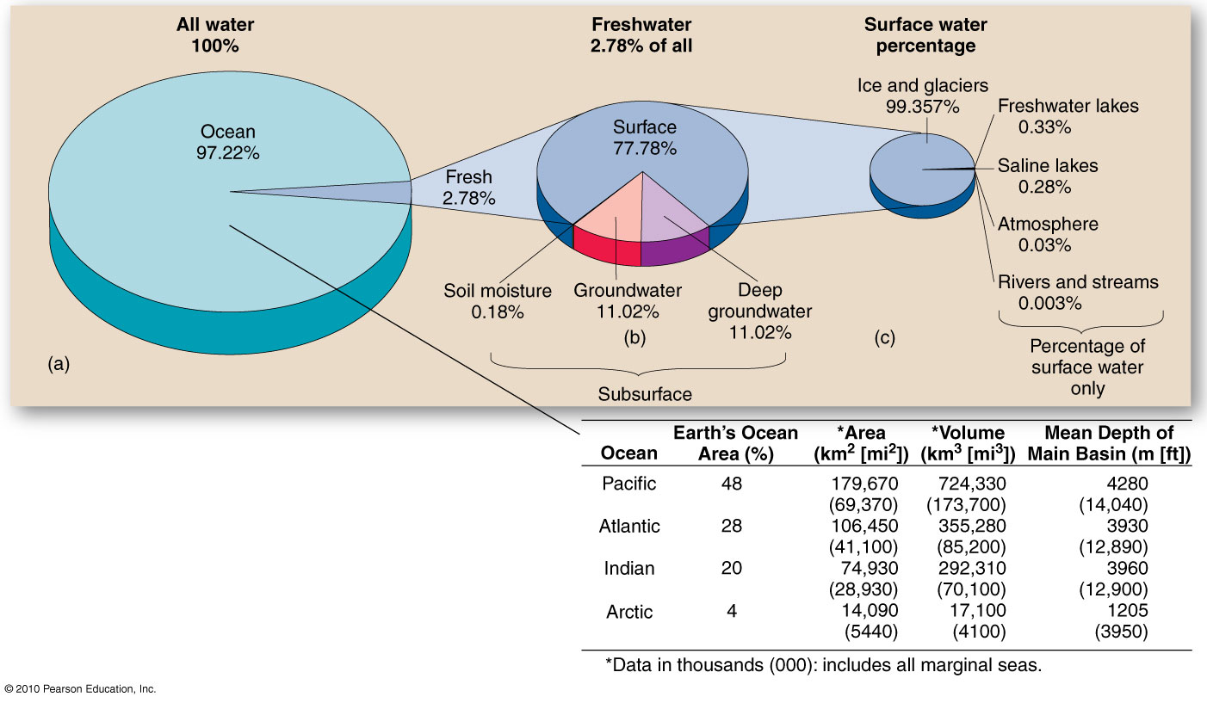
Ocean and Freshwater Distribution
Figure 5.3
Christopherson, Elemental Geosystems, Sixth Edition
Copyright © 2010 Pearson Education, Inc.

Slide 7
Unique Properties of Water
Earth’s temperate location from the Sun allows all states of water:
ice, water, water vapor
Molecule of water H₂0:
Unique stability
Versatile bond
Extraordinary heat characteristics
Most common compound on the surface of earth
Polarity: attraction of H⁺ and O²⁻
Hydrogen bonding
Universal solvent
Surface tension; the cause of capillarity

Slide 8
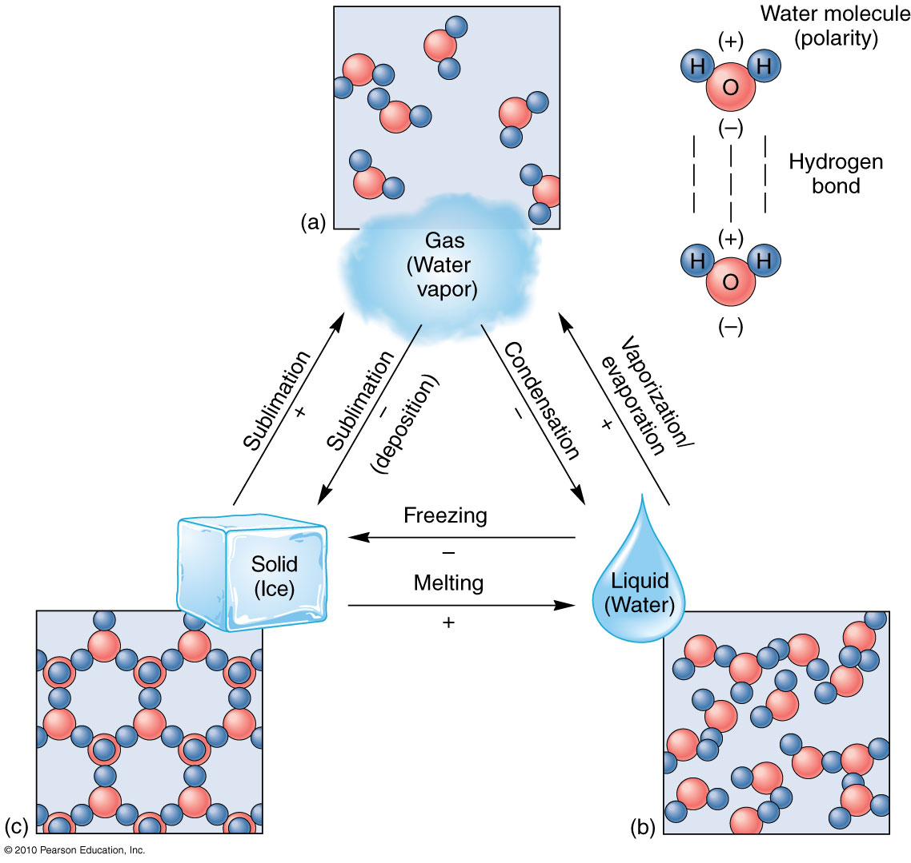
Three States of Water
(+) and (-) symbols on the
phase changes denoted
where heat is absorbed
or liberated.
Figure 5.4
Christopherson, Elemental Geosystems, Sixth Edition
Copyright © 2010 Pearson Education, Inc.

Slide 9
Heat Properties
For water to change from one state to another, heat energy must be added or released from it
Heat exchanged in the phase changes of water provides over 30% of the energy powering the general circulation of the atmosphere
Melting & freezing; phase change between solid and liquid and vice versa
Latent heat of melting (80 calories absorbed) or freezing (80 calories released)
Condensation, evaporation or vaporization; phase change between liquid and vapor
Latent heat of vaporization – 540 calories must be absorbed
Sublimation; direct change of water vapor to ice
Heat properties of water in nature
In a lake at 20 degrees C latent heat of evaporation - 585 calories absorbed – felt as evaporative cooling
Reverse with latent heat of condensation – 585 calories for every gram of water is liberated
Water is a major contributor of energy to the atmosphere

Slide 10
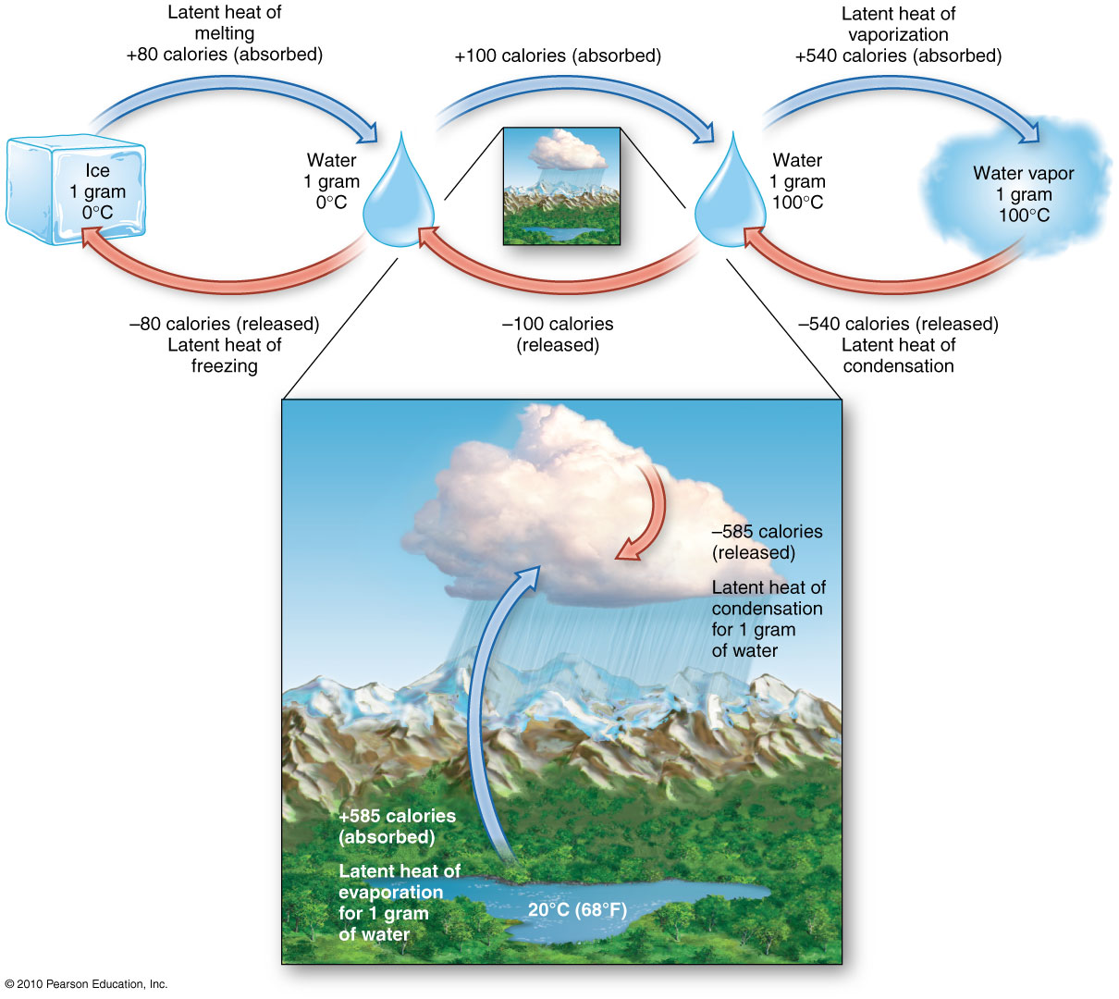
Water’s Heat Energy Characteristics
IN NATURE
Latent heat exchange is the dominant
cooling process in Earth’s energy budget
Figure 5.6
Christopherson, Elemental Geosystems, Sixth Edition
Copyright © 2010 Pearson Education, Inc.

Slide 11
Humidity
Humidity refers to water vapor in the air
The capacity of air for water vapor is primary a function of temperature
Relative Humidity
A ratio (expressed as a percentage) of the amount of water vapor that is actually in the air compared to the maximum water vapor possible in the air at a given temperature
Warmer air increases the evaporation rate from water surfaces
Cooler air tends to increase the condensation rate of water vapor to water surfaces
Saturation occurs when the rate of evaporation and the rate of condensation reach equilibrium, which is 100% humidity
Therefore at this point any further addition of water vapor or decrease in temperature that affects evaporation results in condensation
The temperature at which a given air mass becomes saturated is the dew-point temperature

Slide 12
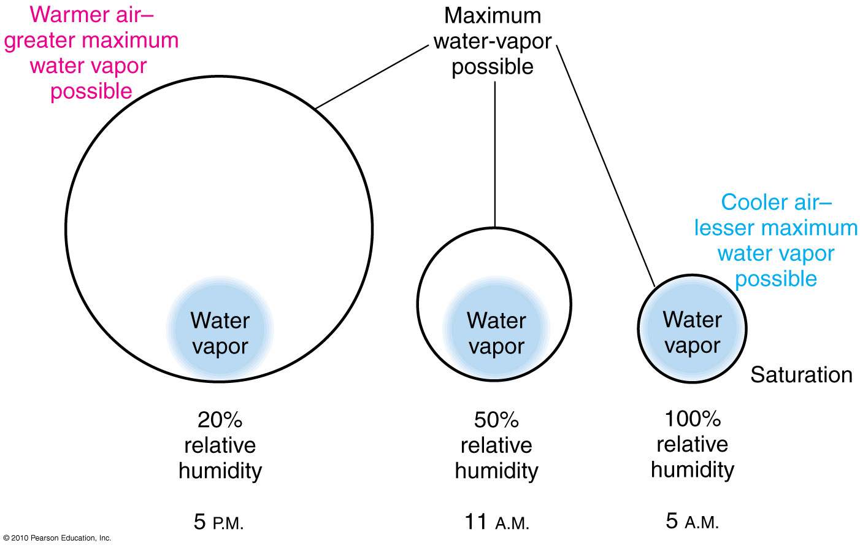
Relative Humidity
Figure 5.7
Christopherson, Elemental Geosystems, Sixth Edition
Copyright © 2010 Pearson Education, Inc.

Slide 13
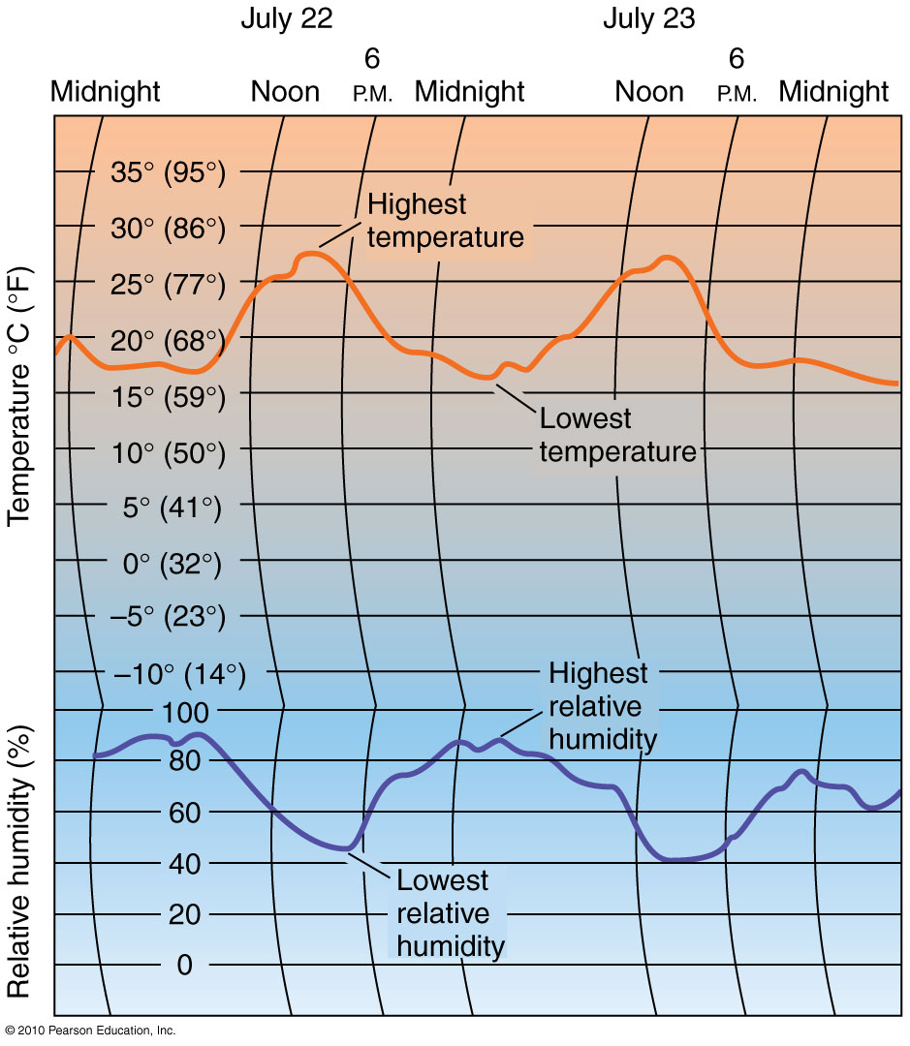
Humidity Patterns
Figure 5.10
Christopherson, Elemental Geosystems, Sixth Edition
Copyright © 2010 Pearson Education, Inc.

Slide 14
Humidity
Expressions of Humidity
Vapor pressure
The portion of total air pressure that is made up of water vapor molecules
Specific humidity
Mass of water vapor (in grams) per mass of air (in kg) at any specified temperature
Remains constant as pressure and temperature changes
Instruments for measurement

Slide 15
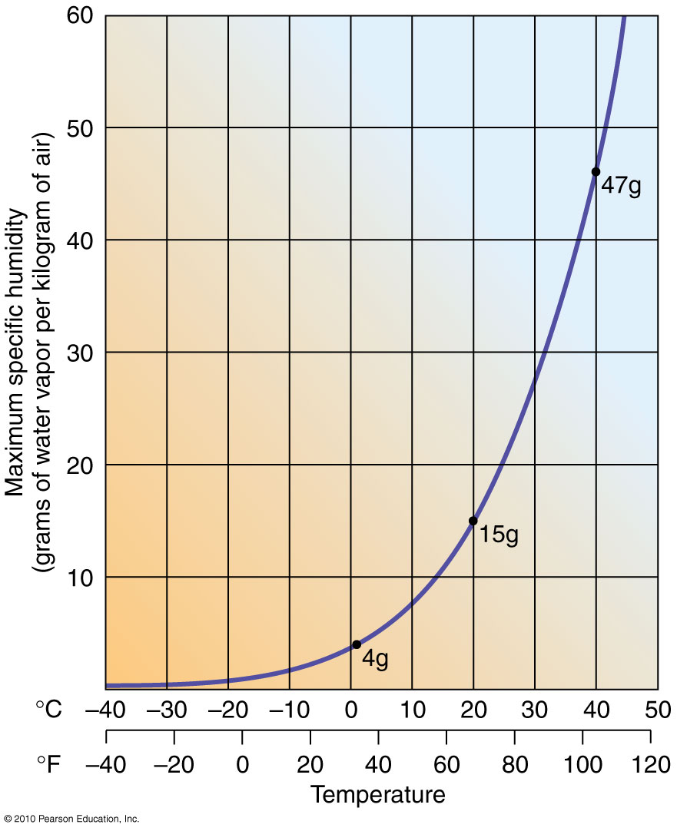
Maximum Specific Humidity
Figure 5.12
Christopherson, Elemental Geosystems, Sixth Edition
Copyright © 2010 Pearson Education, Inc.

Slide 16
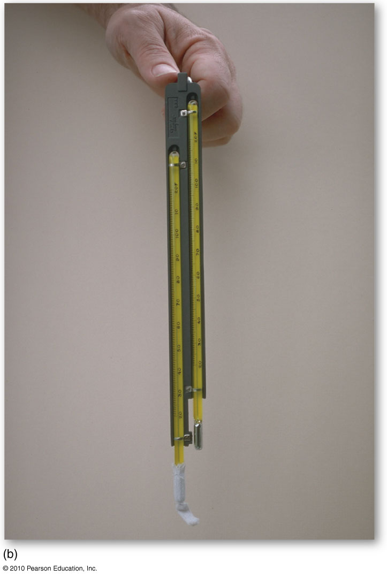
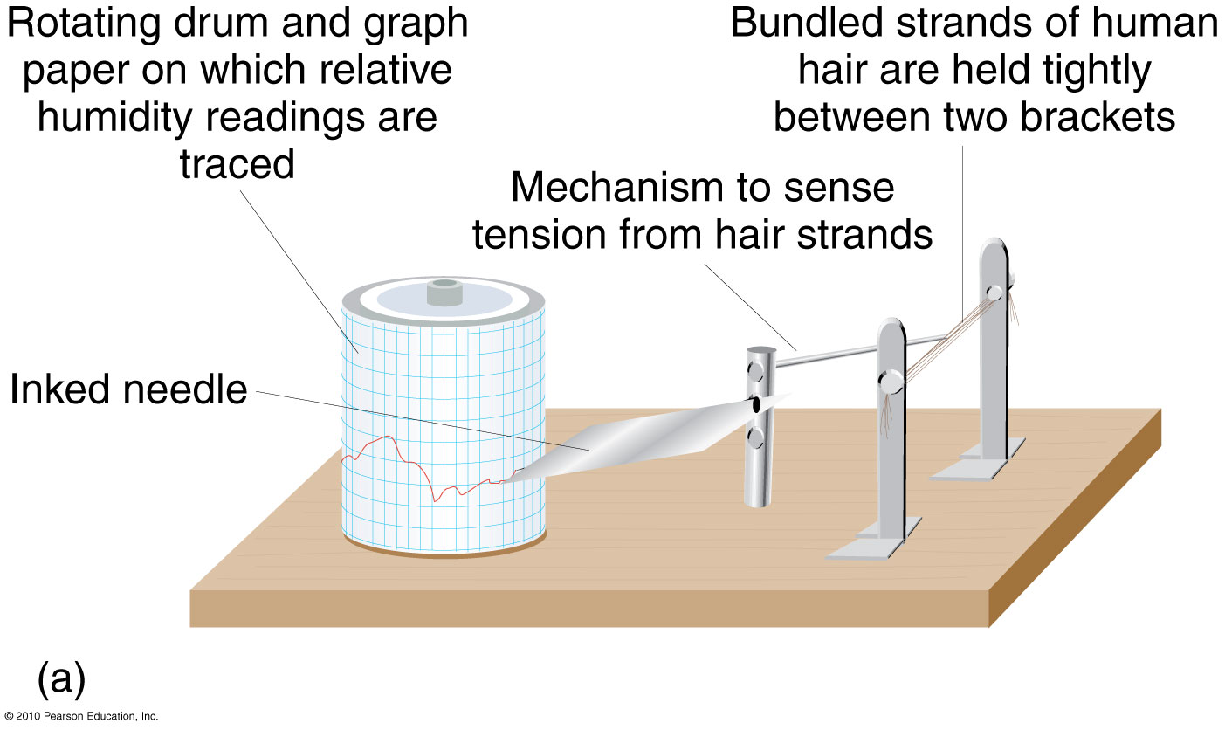
Humidity Instruments
Hair Hygrometer
Figure 5.13
Sling Psychrometer

Slide 17
Atmospheric Stability
A body of air that has specific temperature and humidity characteristics – parcel
A parcel of lower density will rise and expand
A parcel of higher density will descend and compress
Stability refers to the tendency of an air parcel to remain in place or to change vertical position by ascending or descending

Slide 18
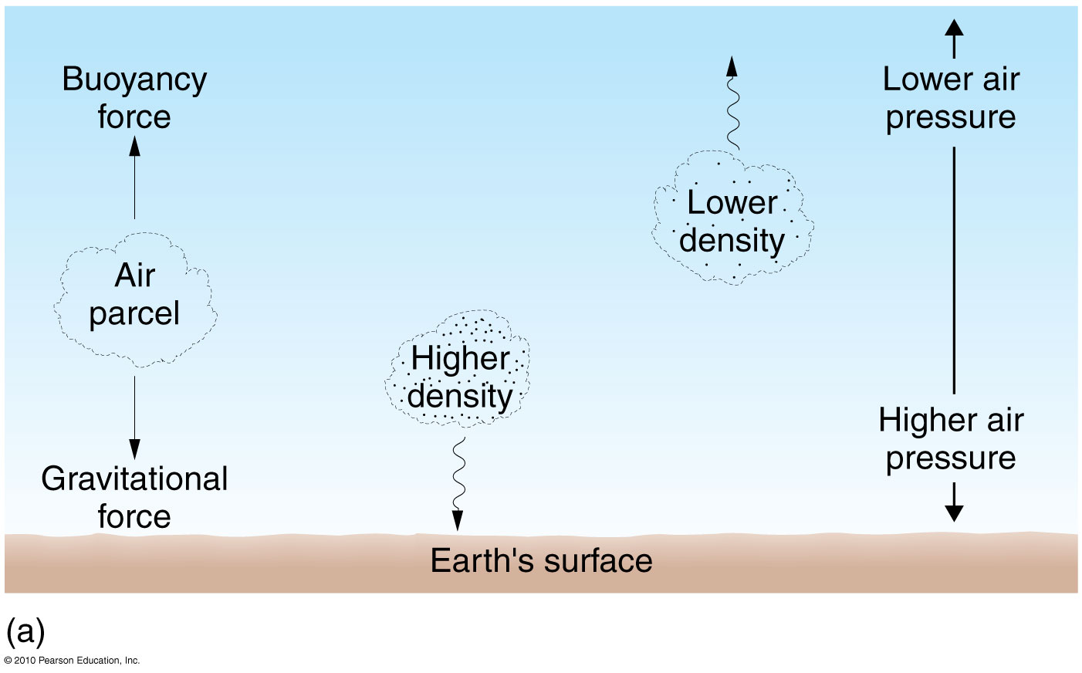
Buoyancy
Figure 5.14a
Christopherson, Elemental Geosystems, Sixth Edition
Copyright © 2010 Pearson Education, Inc.

Slide 19
Atmospheric Stability
An ascending parcel tends to cool by expansion because of reduced pressure at higher altitudes
Descending air tends to heat by compression because of the higher pressures at sea-level
Both descending and ascending temperature changes occur without any exchange between the surrounding environment
The warming and cooling rates for a particular air mass are termed – adiabatic (occurring without a loss of heat)

Slide 20
Atmospheric Stability
Normal lapse rate is for still, calm air;
average decrease in temperature with increasing altitude
Environmental lapse rate – actual lapse rate at a particular space & time
Warming & cooling rates for a parcel of expanding or contracting air are termed adiabatic
Dry adiabatic rate (DAR) – rate at which dry air cools by expansion if ascending or heats by compression if descending; 10ºC per 1000 m
Moist adiabatic rate (MAR) – rate at which ascending air that is moist cools by expansion; 4º - 10ºC per 1000 m
Average rate is 6ºC per 1000 m
Stable and unstable atmospheric conditions

Slide 21
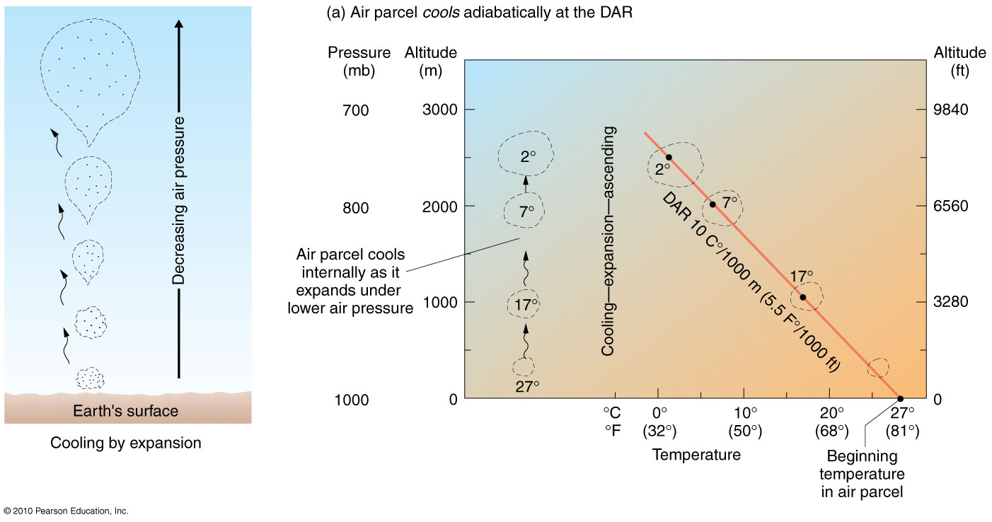

Slide 22
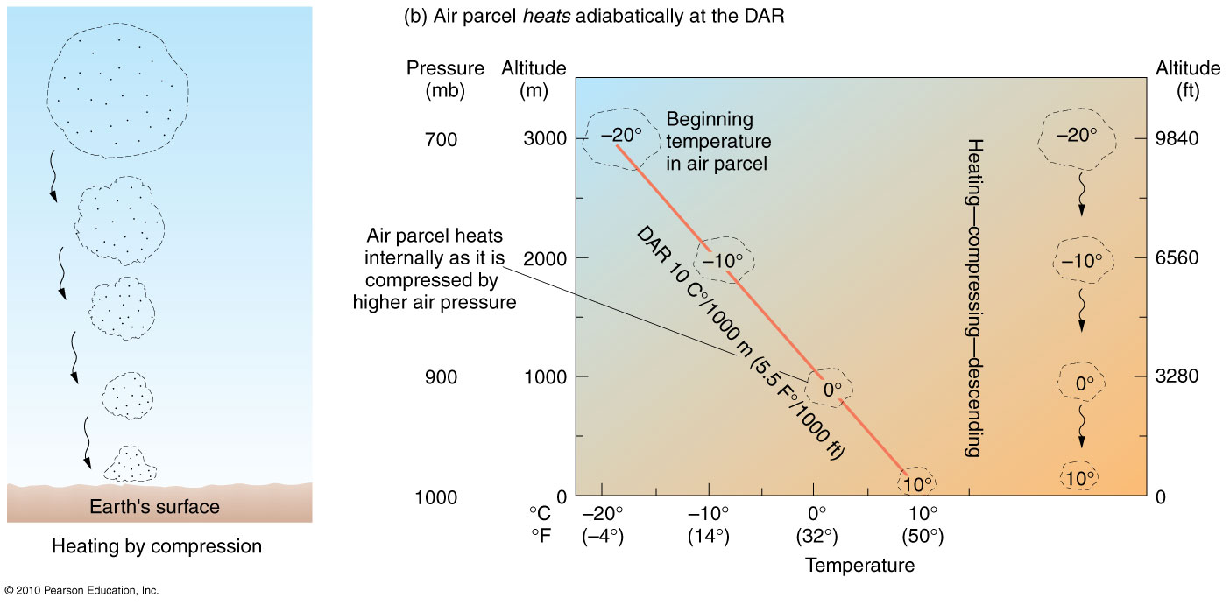

Slide 23
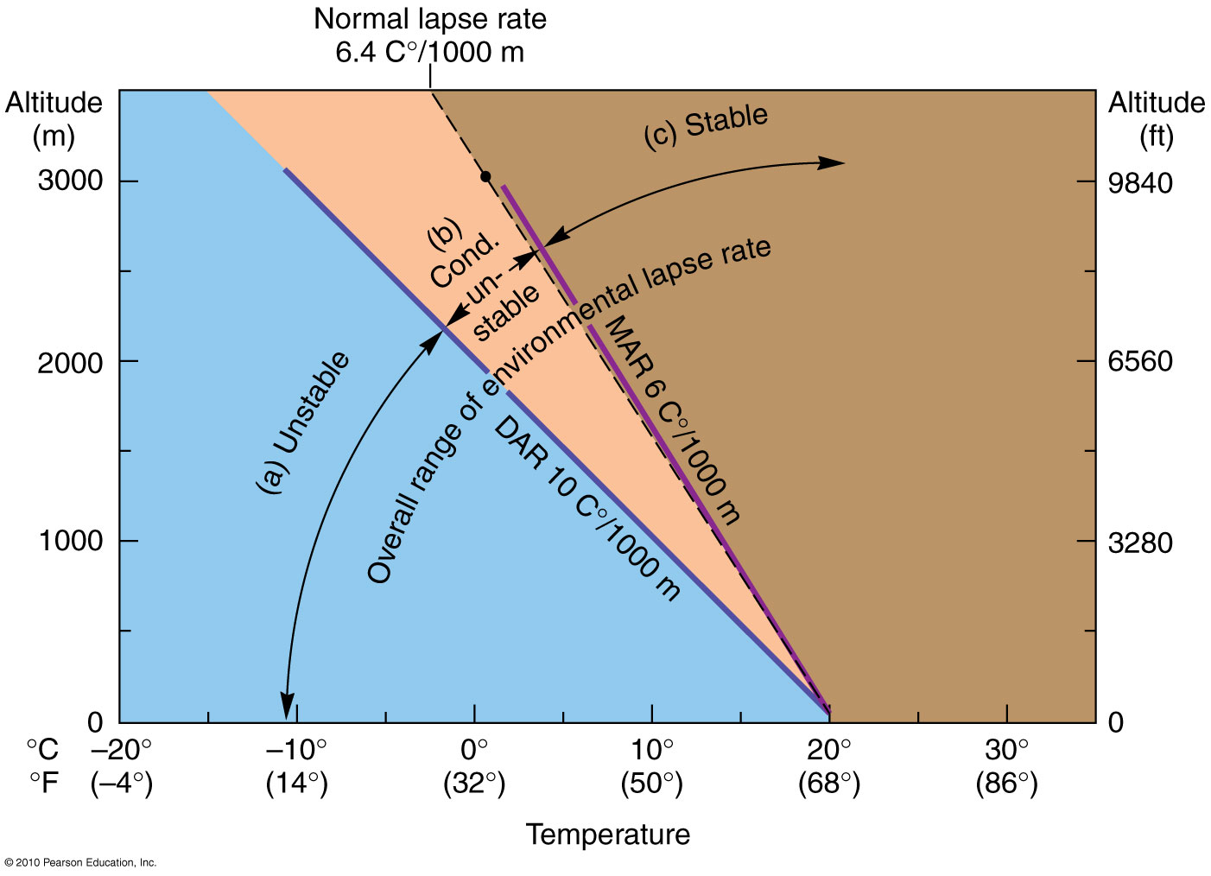
Atmospheric Temperatures and Stability
Figure 5.16
Christopherson, Elemental Geosystems, Sixth Edition
Copyright © 2010 Pearson Education, Inc.

Slide 24
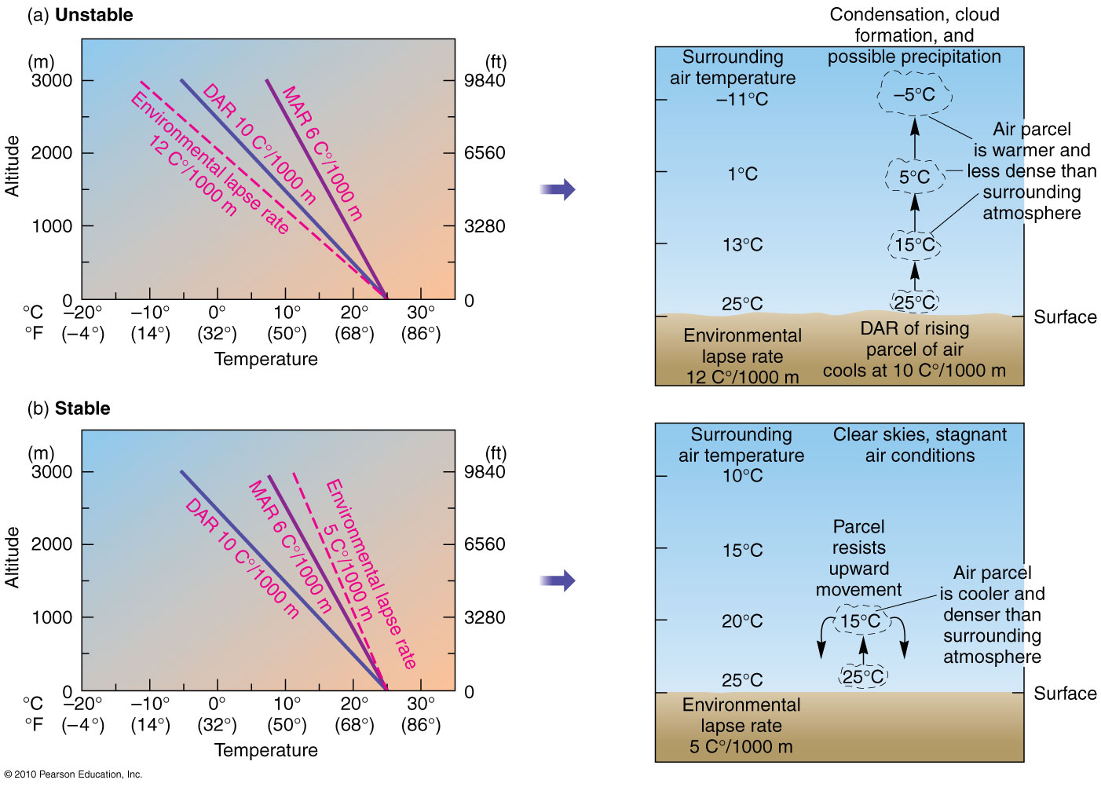

Slide 25
Clouds and Fog
Cloud Types and Identification
Altitude & Shape – key to cloud classification
3 basic forms – flat, puffy & wispy
Flat& layered (horizontally) – stratiform clouds <2000m
Puffy & globular (vertically) – cumuliform
Wispy clouds, usually high in the sky & composed of ice crystals – cirroform > 6000m
4 primary altitude classes
Low, middle, high, and those that vertically develop through these altitudes

Slide 26
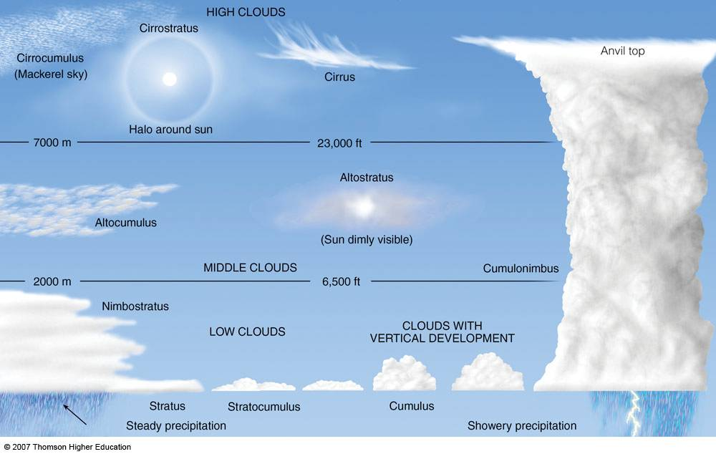
Common Cloud Types in the Troposphere

Slide 27
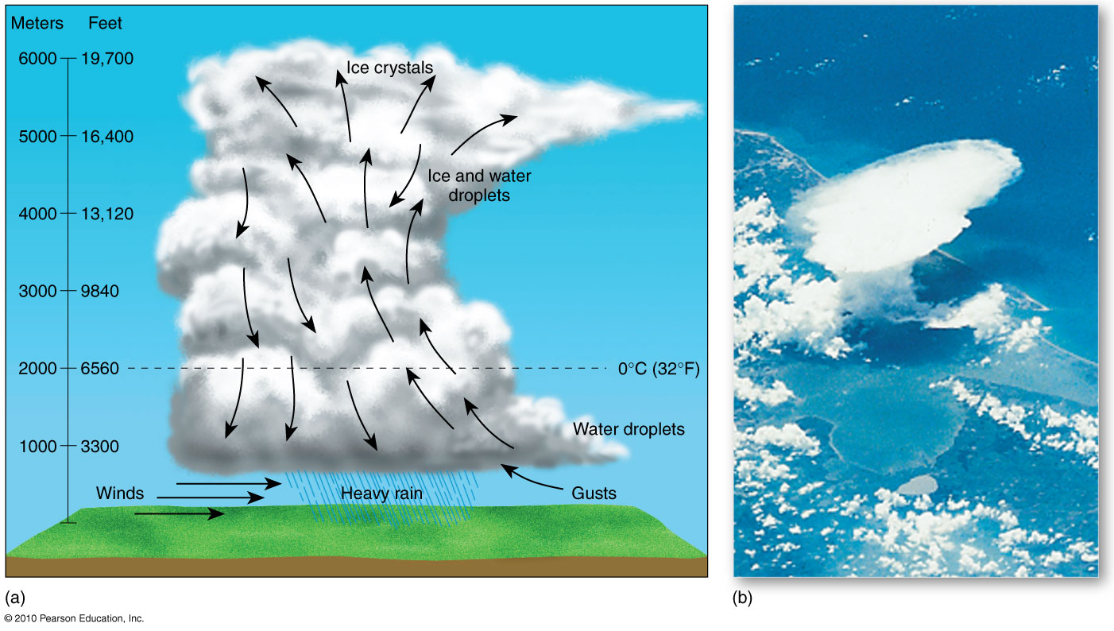
Cumulonimbus Development
Cumulonimbus thunderhead
Figure 5.19
Christopherson, Elemental Geosystems, Sixth Edition
Copyright © 2010 Pearson Education, Inc.

Slide 28
Clouds and Fog
Fog
Cloud layer on the ground restricting visibility to <1km
Air temperature and dew-point temperature at ground level are nearly the same causing saturated conditions:
Advection fog
Air in one place migrates to another where saturated conditions exist; warm moist air overlays cooler ocean currents, lakes or snow masses
Evaporation fog – cold air flows over the warm water of a lake
Upslope fog – moist air is forced to higher elevation along a hill or mountain – forms a stratus cloud at the level of saturation
Valley fog – cool air flows to low lying area, producing a fog in the chilled, saturated layer near the ground
Radiation fog
As the surface cools it chills the air layer above, creating saturated conditions

Slide 29

Advection Fog
Figure 5.20
Christopherson, Elemental Geosystems, Sixth Edition
Copyright © 2010 Pearson Education, Inc.

Slide 30
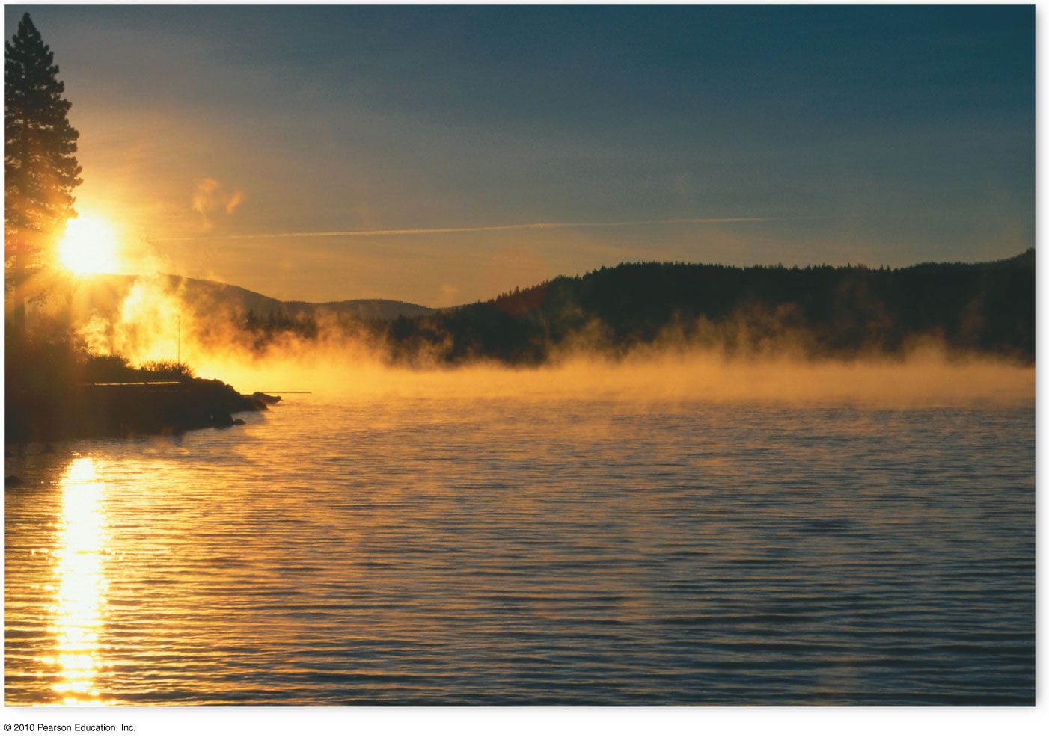
Evaporation Fog
Figure 5.21
Christopherson, Elemental Geosystems, Sixth Edition
Copyright © 2010 Pearson Education, Inc.

Slide 31
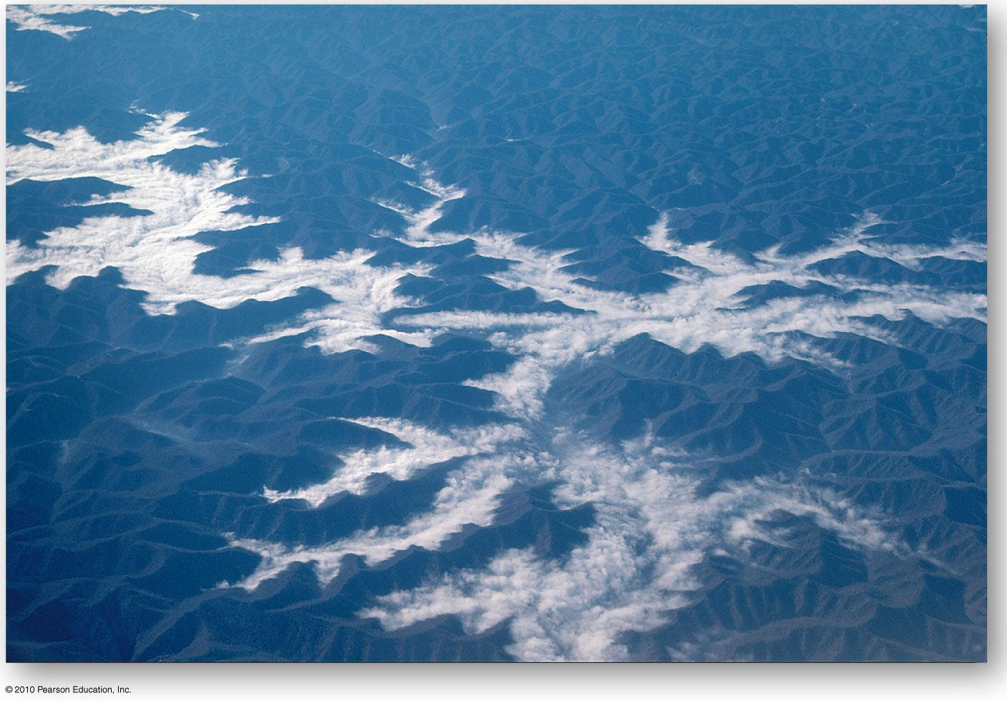
Valley Fog
Figure 5.22
Christopherson, Elemental Geosystems, Sixth Edition
Copyright © 2010 Pearson Education, Inc.

Slide 32
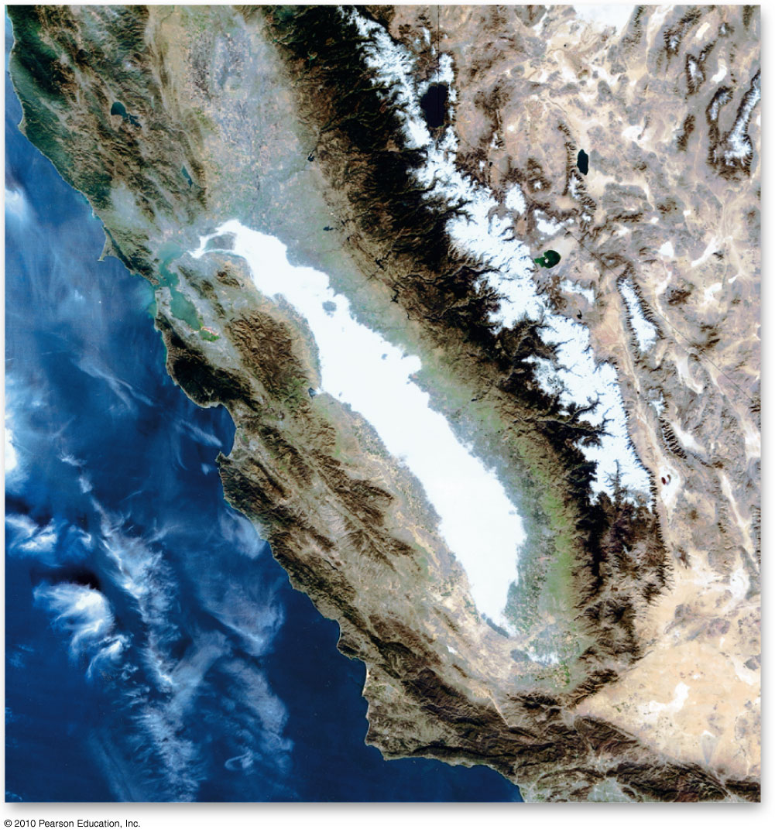
Radiation Fog
Figure 5.23
Christopherson, Elemental Geosystems, Sixth Edition
Copyright © 2010 Pearson Education, Inc.

Slide 33
Air Masses
Earth’s surface imparts its varying characteristics to the air it touches
Each air mass has a distinct homogeneity of temperature & humidity
Air masses are classified according to moisture & temperature characteristics of their source regions
Moisture: ‘m’ for maritime and ‘c’ for continentality
Temperature (latitude): A (Arctic), P (Polar), T (Tropical), E (Equatorial), AA (Antarctic)

Slide 34
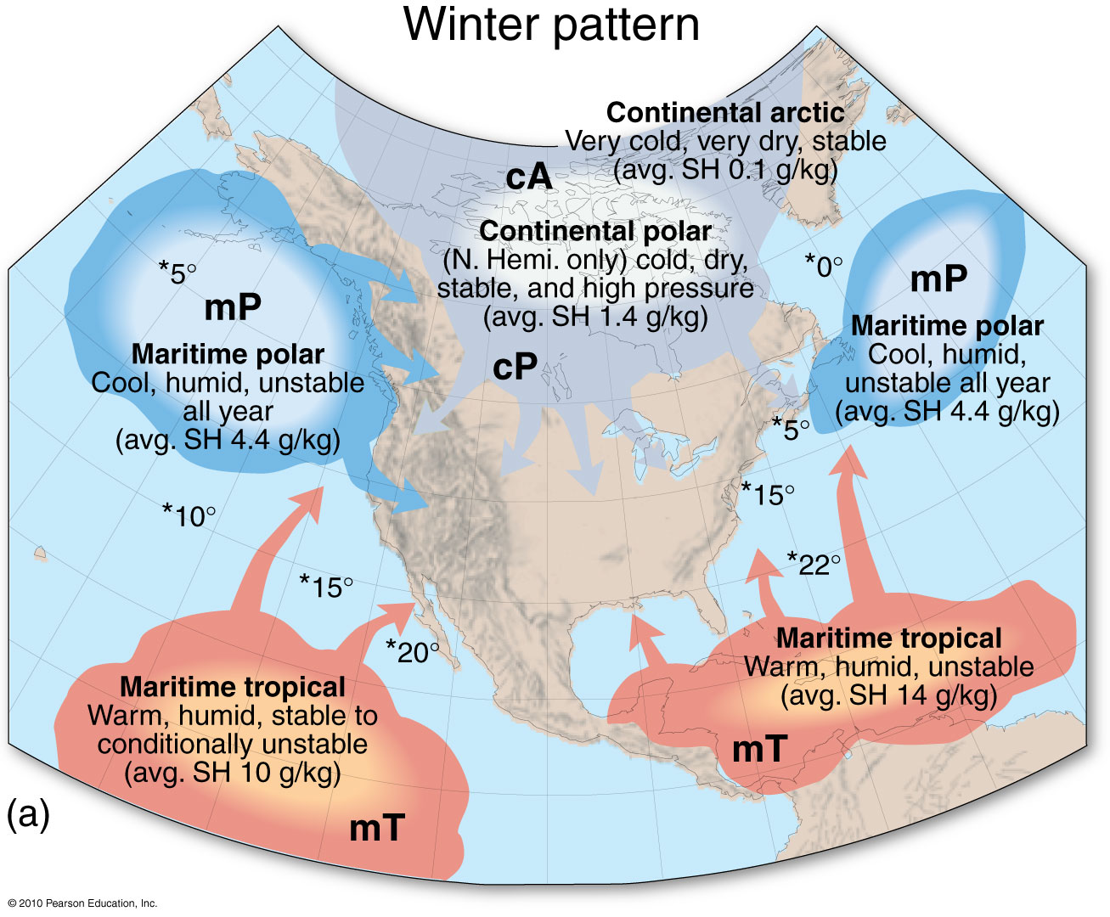
Figure 5.25

Slide 35
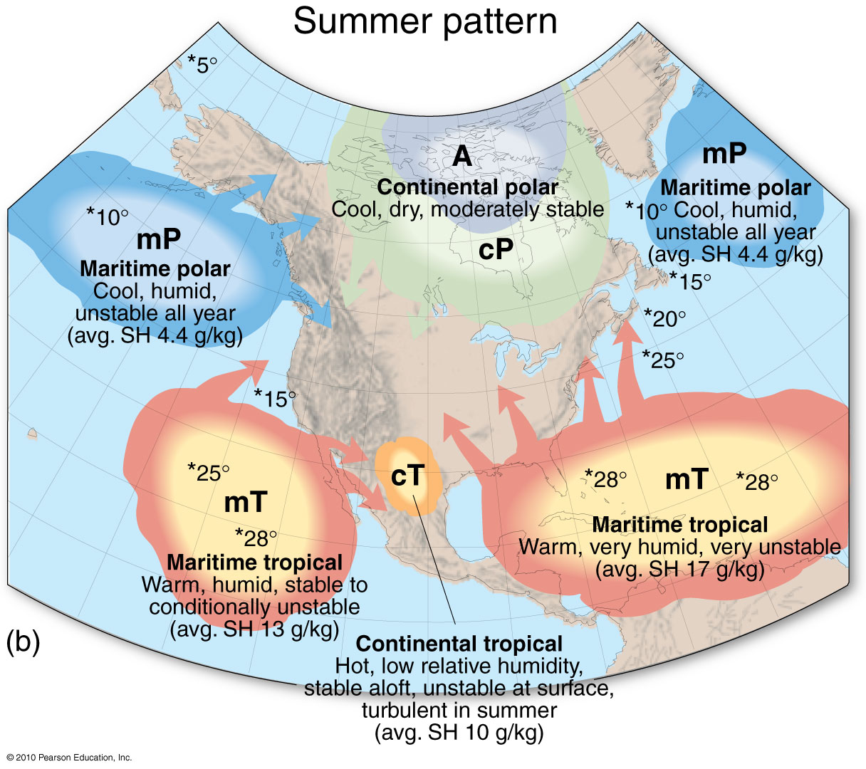

Slide 36
Atmospheric Lifting Mechanisms
Convergent Lifting
Air flows toward an area of low pressure; ITCZ
Towering cumulonimbus clouds and high average precipitation
Convectional Lifting
Stimulated by local surface heating
Air mass passes over a warmer region, heating from the warmer land causes lifting in the air mass; if unstable, clouds develop
Orographic Lifting
Air forced over a barrier such as a mountain range
Chinook formation - air rises upslope as it pushes against a mountain; it cools adiabatically; stable air forms stratiform clouds; unstable air forms a line of cumulus or cumulonimbus clouds
Air can begin its ascent up a mountain warm and moist but finish its descent hot and dry

Slide 37
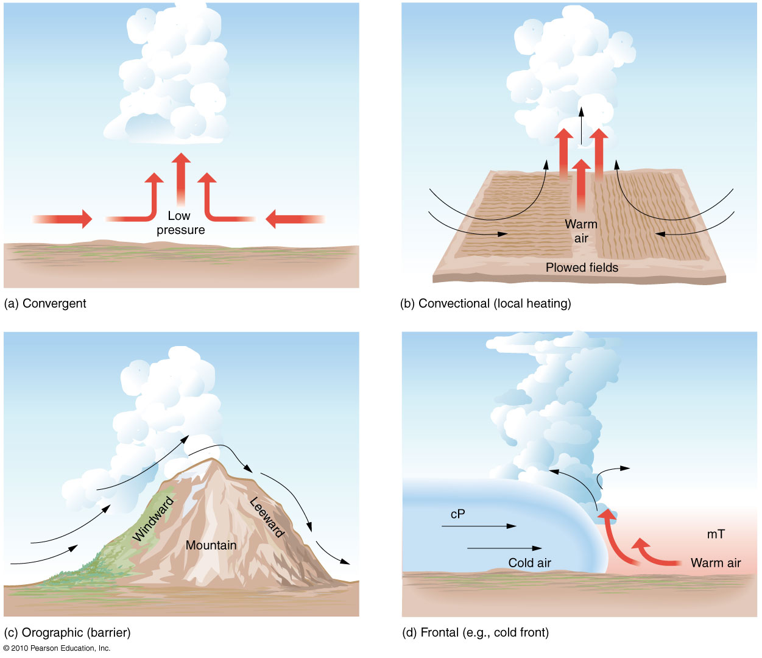
Atmospheric Lifting Mechanisms
Figure 5.27
Christopherson, Elemental Geosystems, Sixth Edition
Copyright © 2010 Pearson Education, Inc.

Slide 38
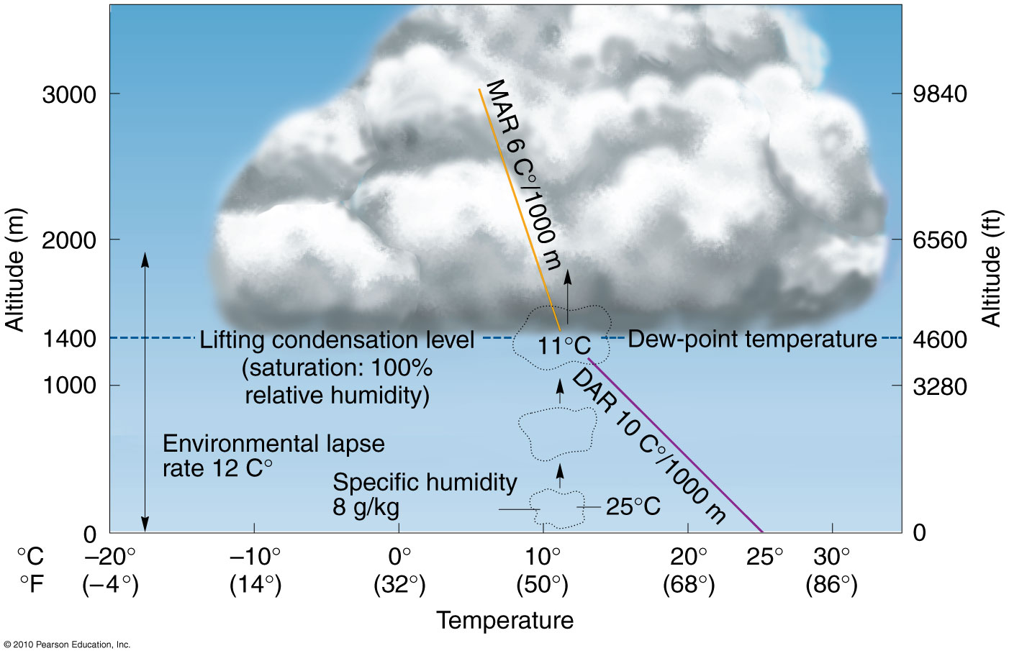
Local Heating and Convection
Figure 5.28
Christopherson, Elemental Geosystems, Sixth Edition
Copyright © 2010 Pearson Education, Inc.

Slide 39
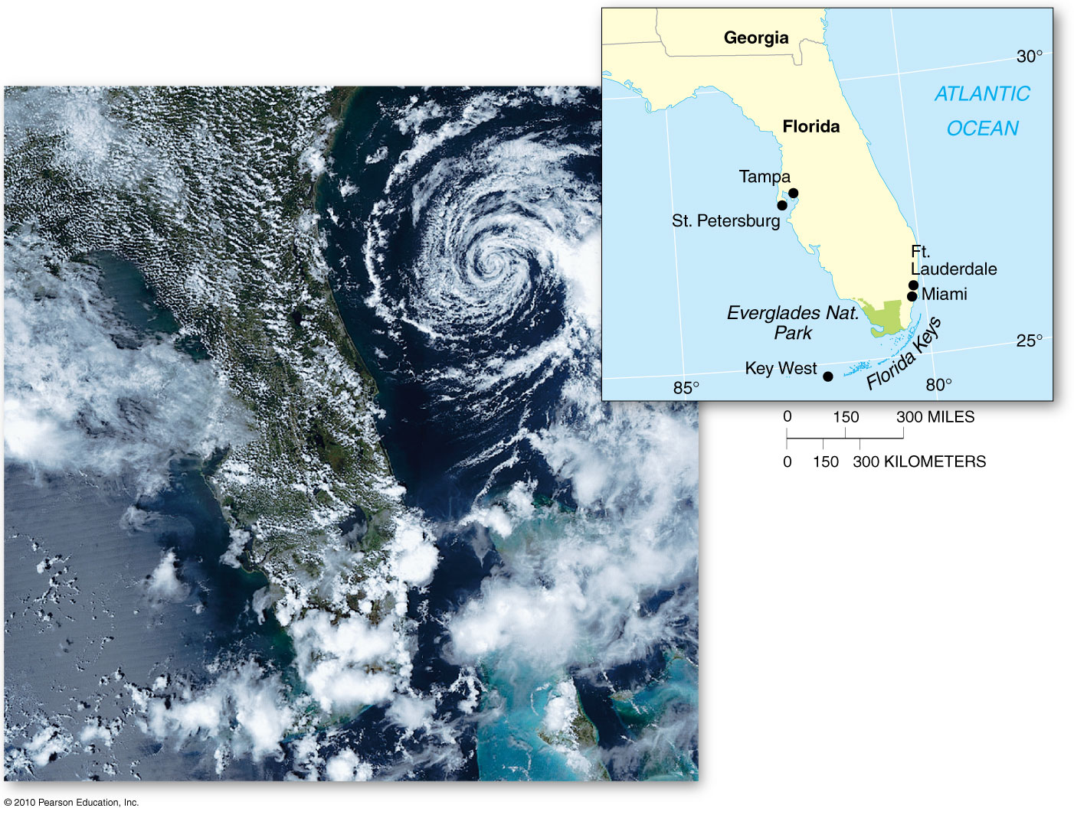
Convection over Florida
Figure 5.29
Christopherson, Elemental Geosystems, Sixth Edition
Copyright © 2010 Pearson Education, Inc.

Slide 40
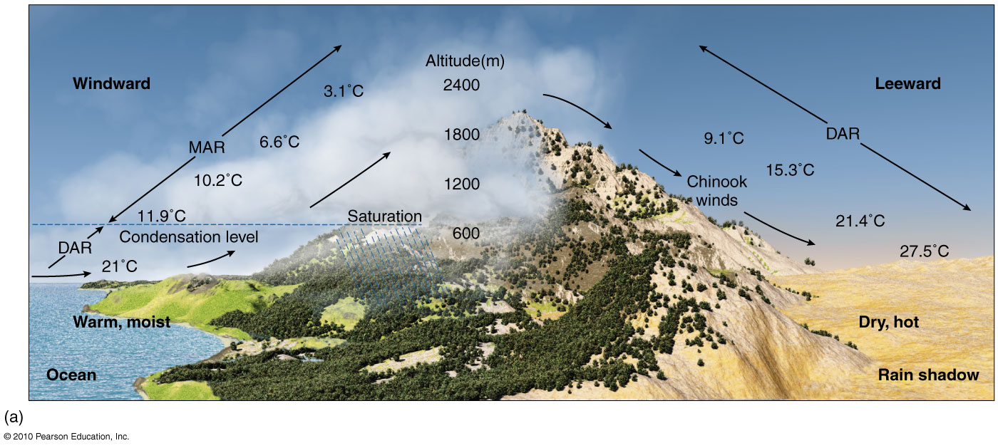
Orographic Precipitation
Figure 5.30a

Slide 41
Atmospheric Lifting Mechanisms
Frontal Lifting (Warm and Cold Fronts)
Cold front: leading edge of a cold air mass
Day or two ahead of the front – high cirrus clouds appear
It’s advance marked by a wind shift, temperature drop, and lowering barometric pressure – low pressure system
Formation of clouds – cumulonimbus types
Precipitation usually hard, accompanied by hail, lightning & thunder
Fast-advancing cold front can cause violent lifting forming a squall line slightly ahead of the front – wind patterns are turbulent and precipitation intense; tornadoes may develop

Slide 42
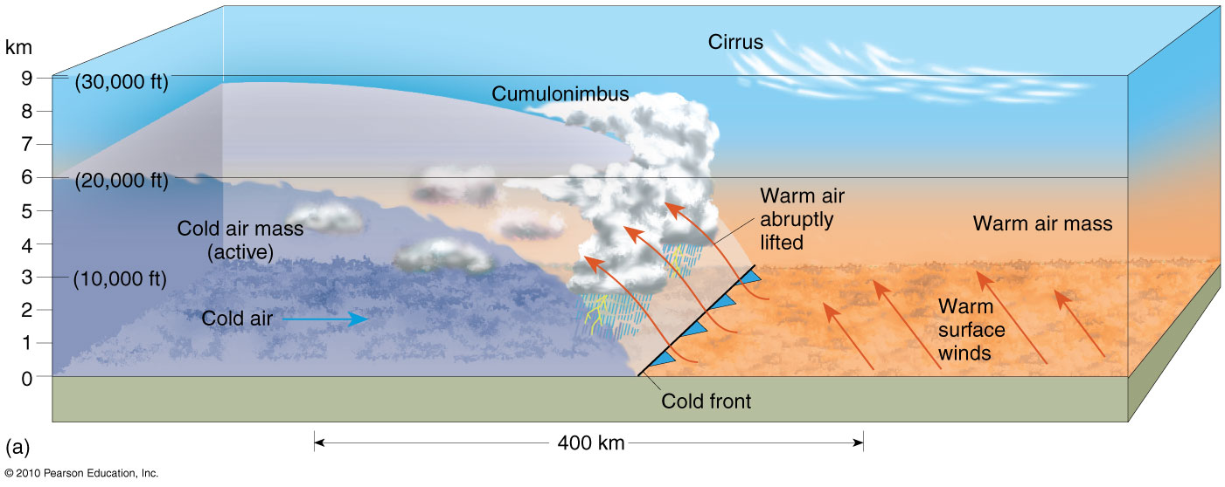
Frontal Lifting - Cold Front
Figure 5.31a

Slide 43
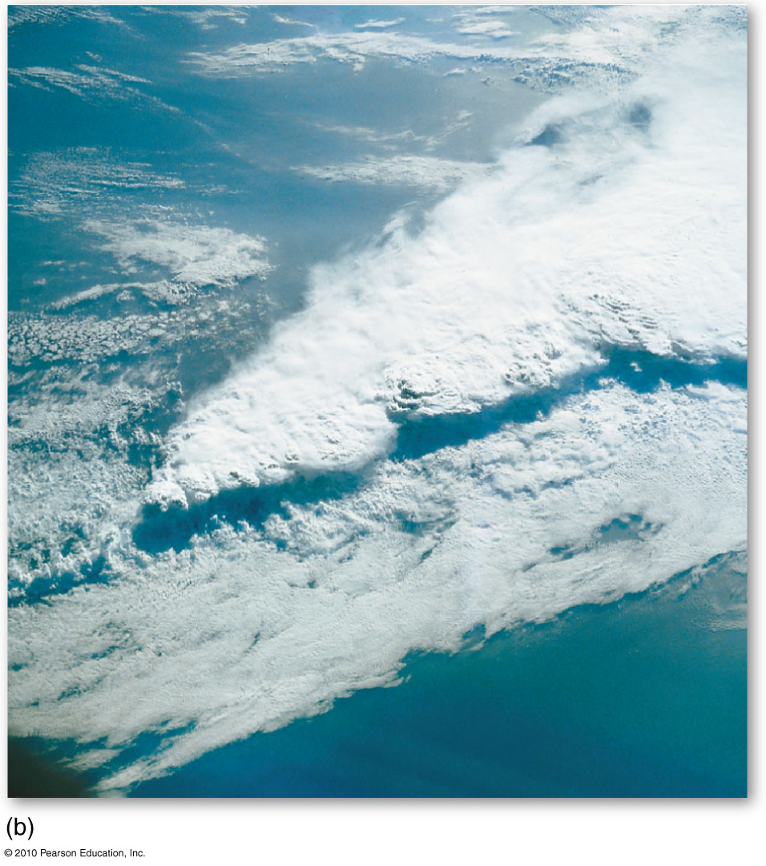
Cold Front and Squall Line
Cumulonimbus clouds
Figure 5.31b
Christopherson, Elemental Geosystems, Sixth Edition
Copyright © 2010 Pearson Education, Inc.

Slide 44
Atmospheric Lifting Mechanisms
Warm front: leading edge of a warm air mass
Warm air tends to push the cooler, dense air into a wedge shape with the warmer air sliding up and over the cooler air
Stratiform cloud development with nimbostratus clouds and drizzly precipitation
High cirrus and cirrostratus clouds are ahead of the advancing warm-front
Cold front moves faster than a warm front

Slide 45
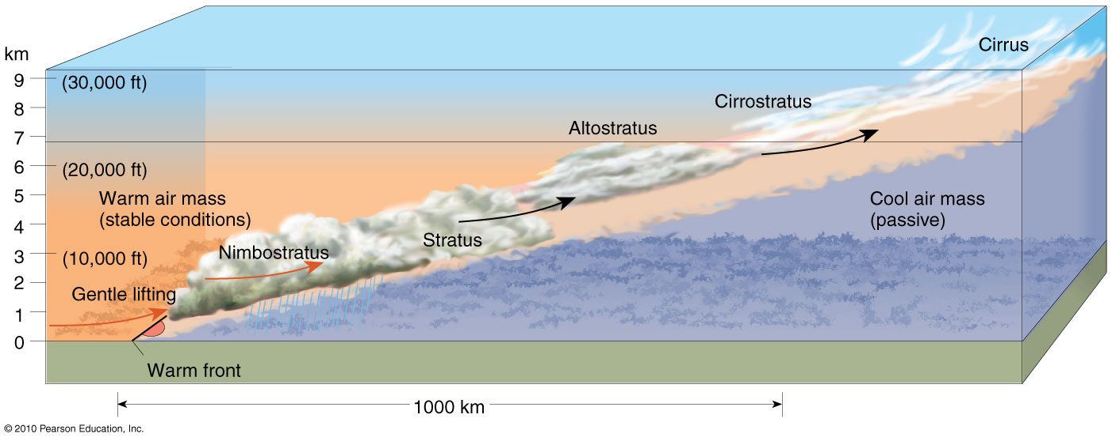
Warm Front
Figure 5.32

Slide 46
Midlatitude Cyclonic Systems
Weather is the short-term condition of the atmosphere vs climate, which is long-term atmospheric conditions and extremes
Meteorology is the scientific study of the atmosphere
Contrasting air masses along fronts leads to unique conditions that causes the development of a midlatitude cyclone or wave cyclone

Slide 47
Midlatitude Cyclonic Systems
Midlatitude Cyclone
Migrating center of low pressure
Converging, ascending air spiraling inward counterclockwise in the NH
These form a dominant type of weather pattern in the middle and higher latitudes in the Northern and Southern hemispheres
Midlatitude cyclones are formed along the polar front, in the Iceland and Aleutian sub-polar low pressure systems

Slide 48
Midlatitude Cyclonic Systems
Life cycle of a Midlatitude Cyclone
Storm tracks
Development & strengthening of a midlatitude cyclone is known as cyclogenesis
Cyclonic circulation frequently develops on the lee side of mountain ranges such as along the Rockies from Alberta to Colorado
Open stage
Occluded stage
Dissolving stage

Slide 49
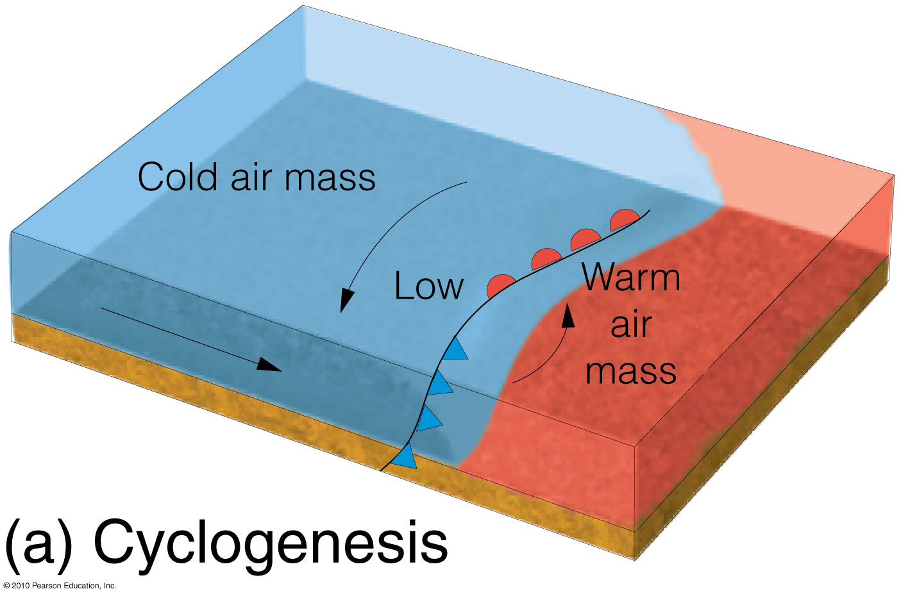

Slide 50
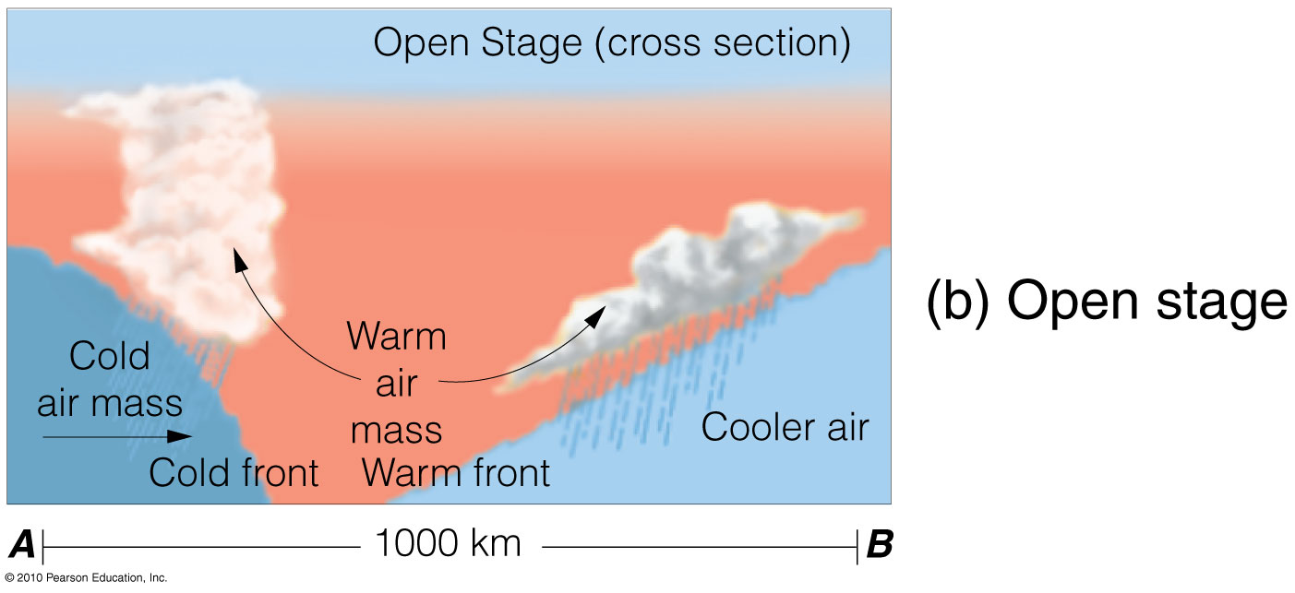
Draws the cold air mass from the north and west and the warm
air from the south

Slide 51
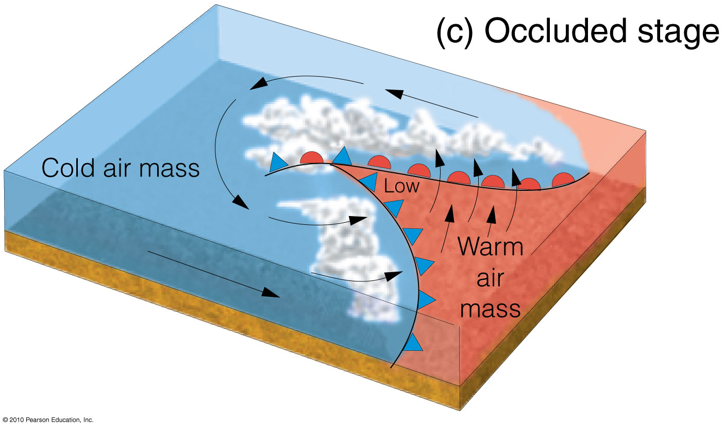
A cold front may overrun the cyclonic warm front
producing an occluded front

Slide 52
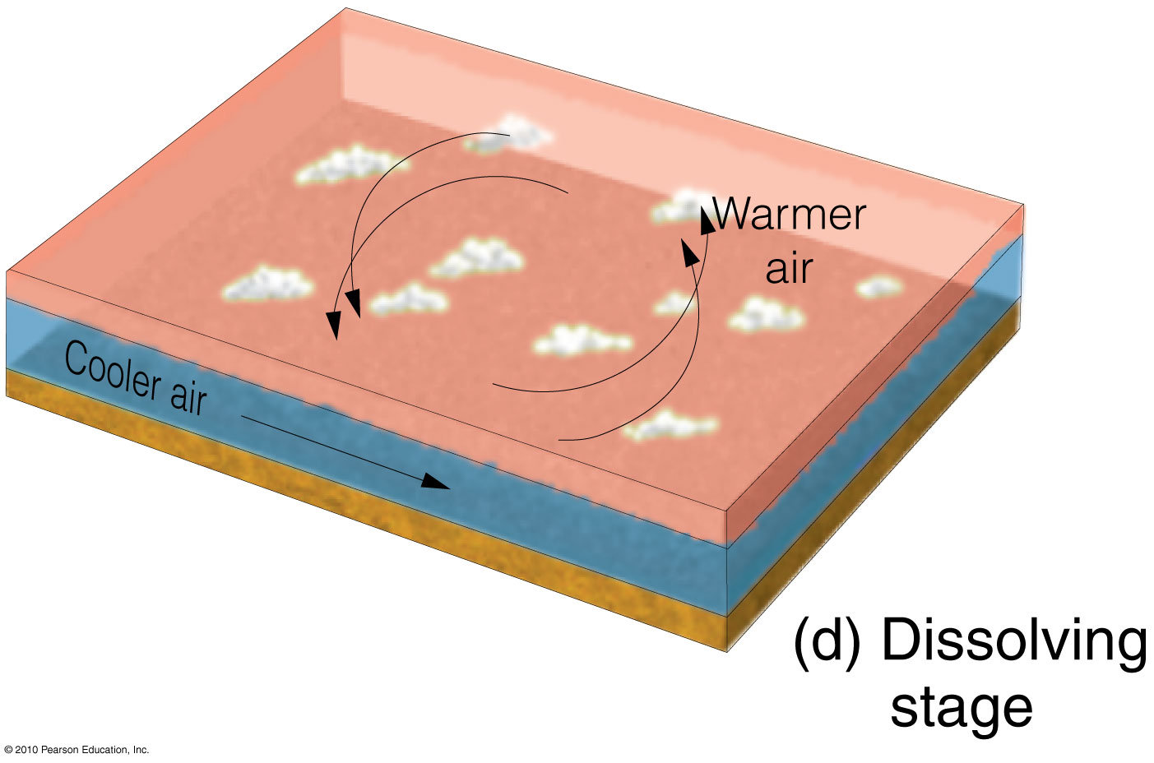

Slide 53
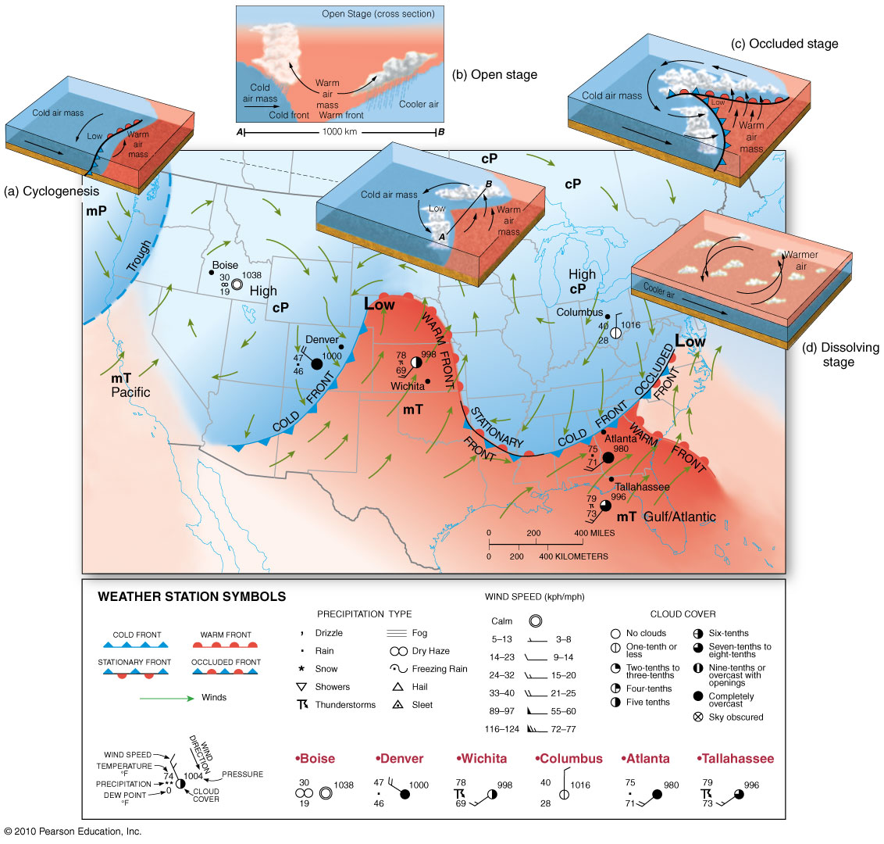
Midlatitude Cyclone
Figure 5.33
Christopherson, Elemental Geosystems, Sixth Edition
Copyright © 2010 Pearson Education, Inc.

Slide 54
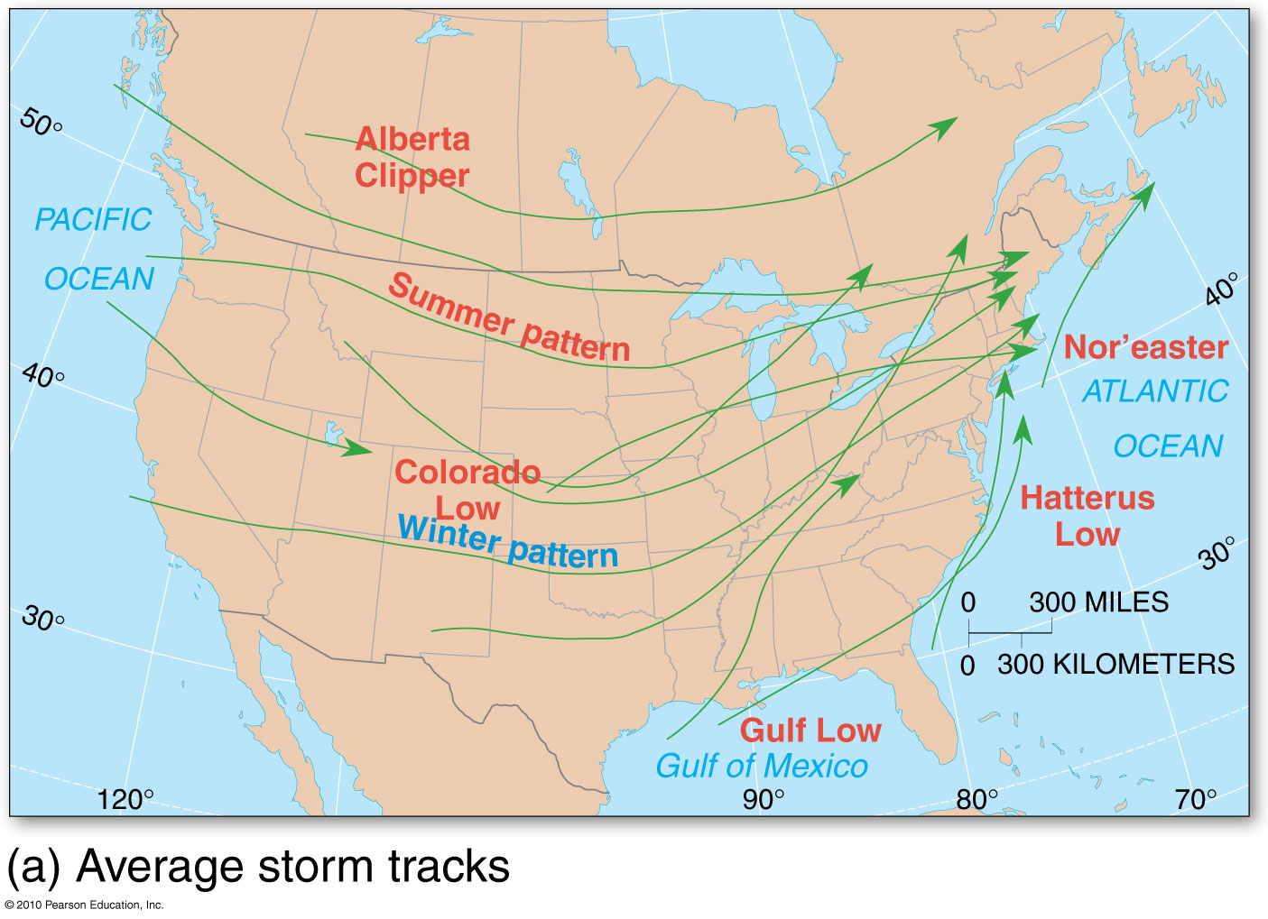
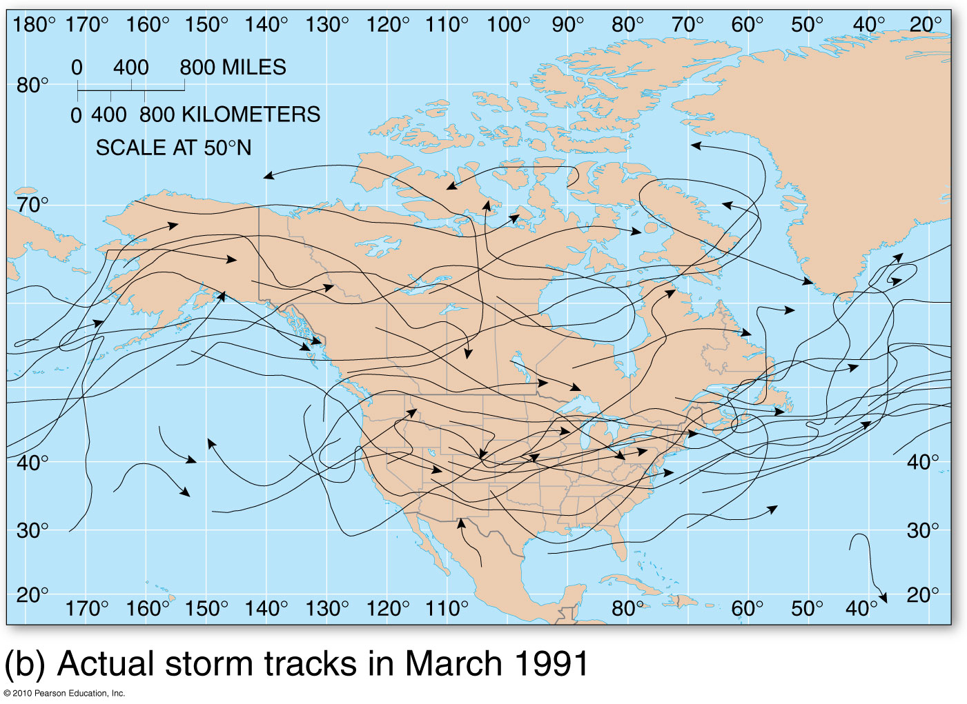
Average and Actual Storm Tracks
Figure 5.34

Slide 55
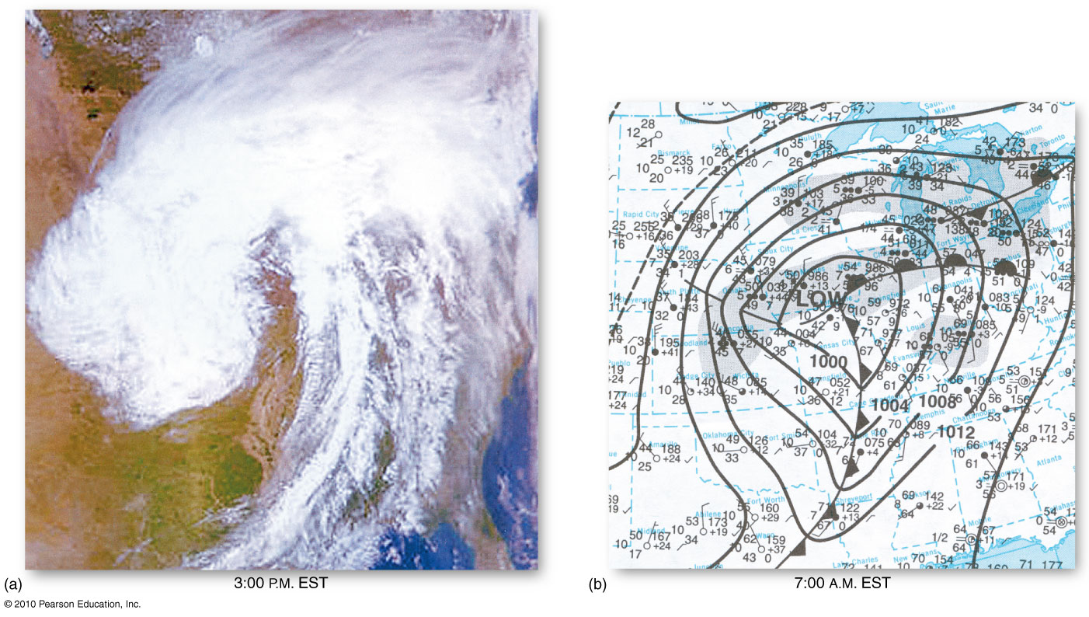
Midlatitude Cyclone
OPEN STAGE
Figure 5.35
Christopherson, Elemental Geosystems, Sixth Edition
Copyright © 2010 Pearson Education, Inc.

Slide 56
Violent Weather
Thunderstorms
Atmospheric turbulence
Lightning and thunder
Hail
Derechos - strong linear winds >26m/s
In Canada called plow winds
Tornadoes
Tornado measurement and science
Tropical Cyclones
Hurricanes and typhoons
Physical structure

Slide 57
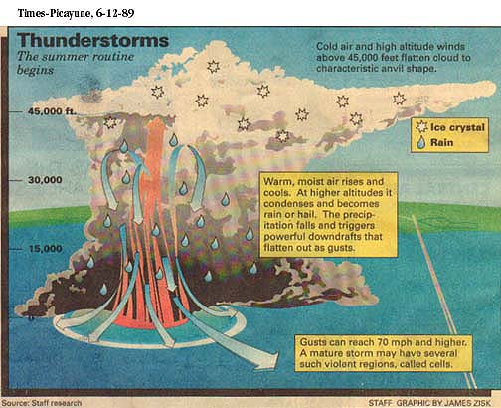

Slide 58
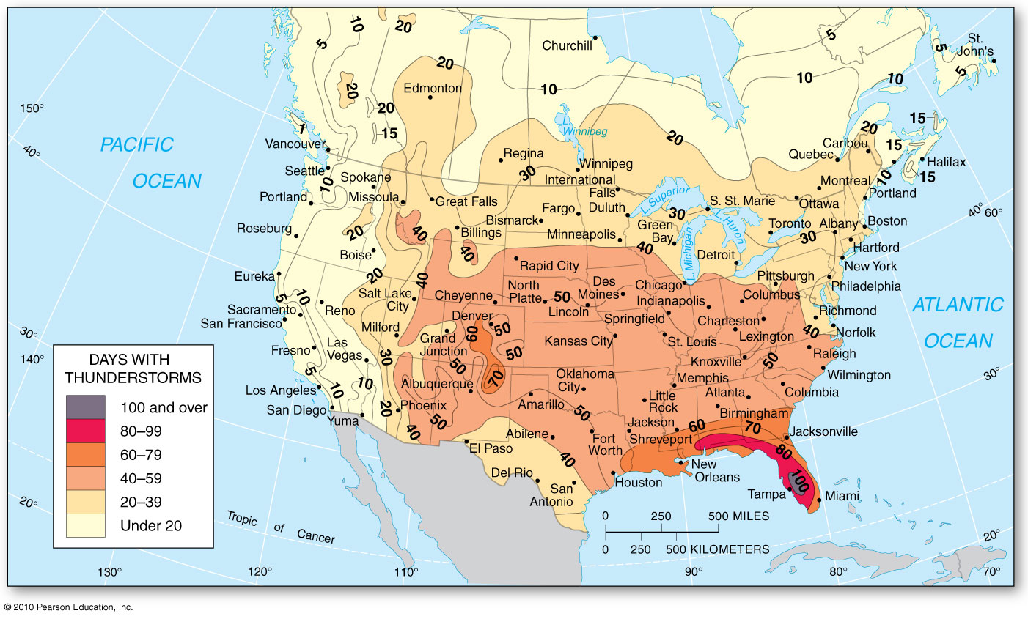
Thunderstorms
Figure 5.36
Christopherson, Elemental Geosystems, Sixth Edition
Copyright © 2010 Pearson Education, Inc.

Slide 59
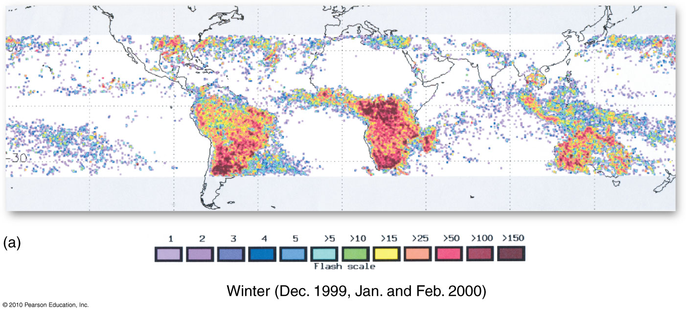
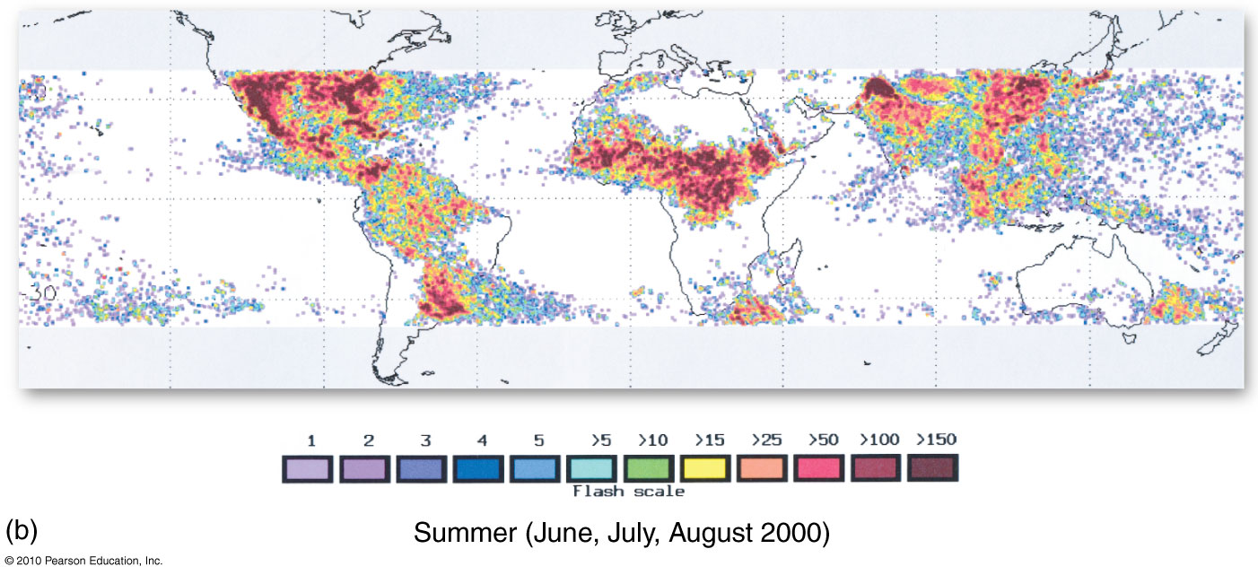
Thunderstorms
Figure 5.37
Christopherson, Elemental Geosystems, Sixth Edition
Copyright © 2010 Pearson Education, Inc.

Slide 60
Tornadoes
Tornado season extends from April to September
Most occur in the months of June – July; frequently developing from mid-afternoon to early evening
Quite unpredictable; move up to 70km/h and can strike without warning

Slide 61
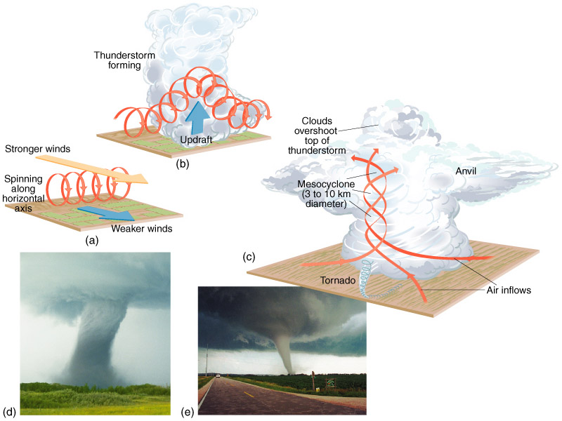
Tornadoes
Figure 8.24

Slide 62
Tornadoes
Typically preceded by severe thunderstorms black skies, strong winds, lightening, thunder’ heavy rainfall or hail
Many times the skies turn an unusual green colour and the wind sounds like a freight train
Rotating columns of high velocity winds that devastate anything in their paths

Slide 63
Tornadoes
Tornado formation: three very different types of air are needed to come together in a particular way:
Near the ground, layer of warm, humid air and strong south winds. In the upper atmosphere, colder air and strong west or southwest winds.
A change in wind speed and direction with height, called wind shear. This is linked to the eventual development of rotation from which a tornado may form.
A layer of hot, dry air between the upper and lower layers.
This middle layer acts as a cap and allows the warm air underneath to get even warmer and make the atmosphere even less stable.

Slide 64
The Fujita Scale
F-scale Wind speed (km/h) Damage
F-0 64 - 116 Light
F-1 117 - 180 Moderate
F-2 181 - 253 Considerable
F-3 254 - 331 Severe
F-4 332 - 418 Devastating
F-5 419 - 512 Massive devastation

Slide 65
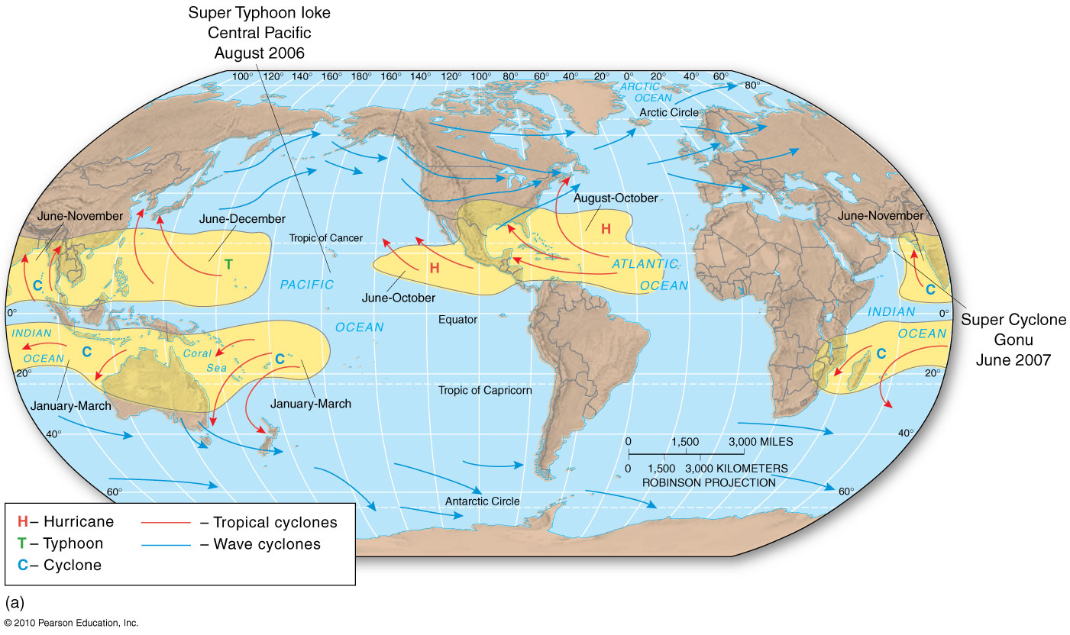
Tropical Cyclones
Figure 5.40a
Christopherson, Elemental Geosystems, Sixth Edition
Copyright © 2010 Pearson Education, Inc.

Slide 66
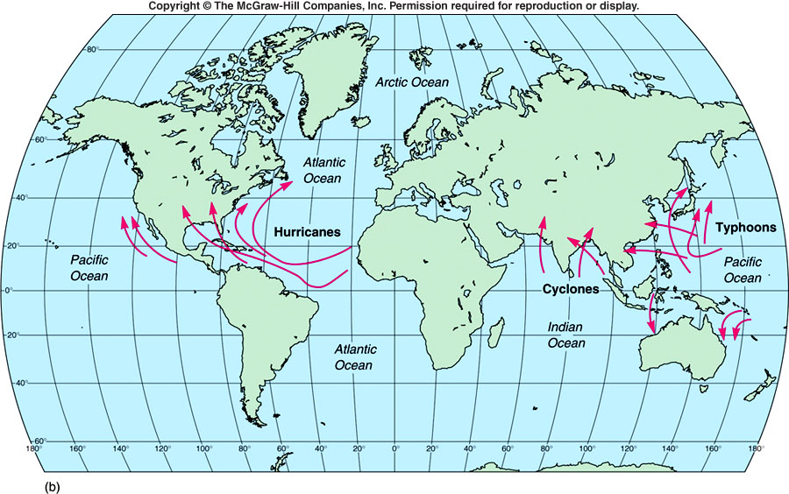
General Hurricane Paths

Slide 67
Hurricanes
Hurricane Katrina was the costliest (damage cost exceeding $50 billion) and one of the deadliest hurricanes (fatalities directly & indirectly topping 1300) in the history of the U.S
It was the sixth-strongest Atlantic hurricane ever recorded and the third-strongest land-falling U.S. hurricane on record.
Katrina formed in late August during the 2005 hurricane season and caused devastation along much of the north-central Gulf Coast of the central U.S.

Slide 68
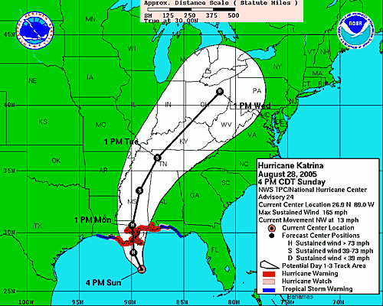

Slide 69
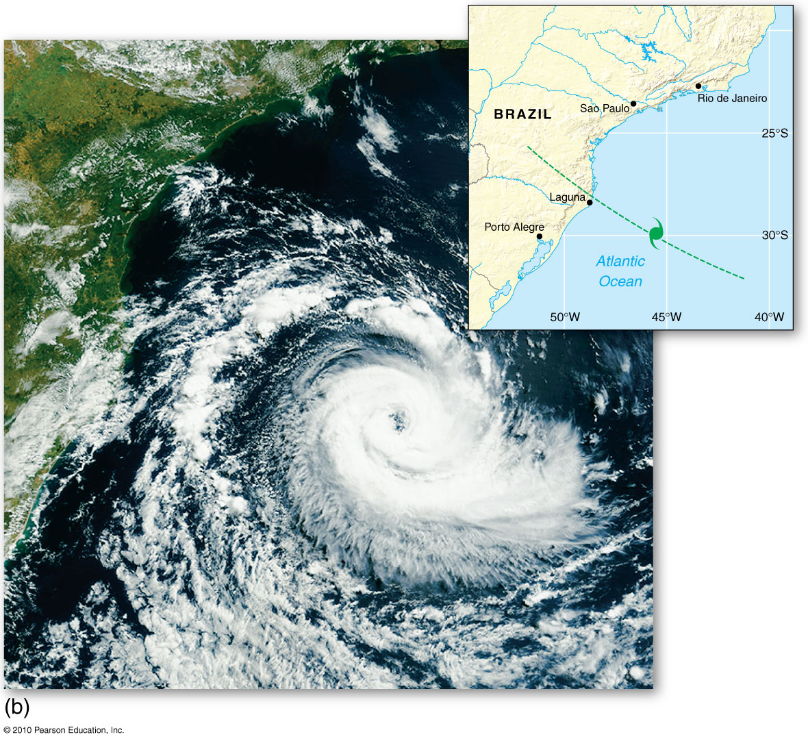
Brazilian Hurricane
Figure 5.40b
Christopherson, Elemental Geosystems, Sixth Edition
Copyright © 2010 Pearson Education, Inc.

Slide 70
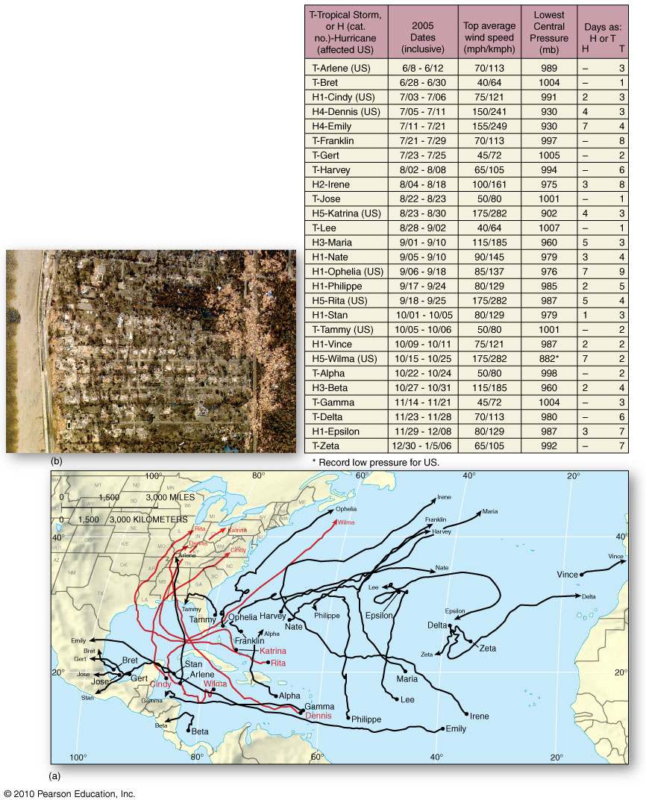
2005 Hurricane Season
Figure FS 5.1.1
Christopherson, Elemental Geosystems, Sixth Edition
Copyright © 2010 Pearson Education, Inc.

Slide 71
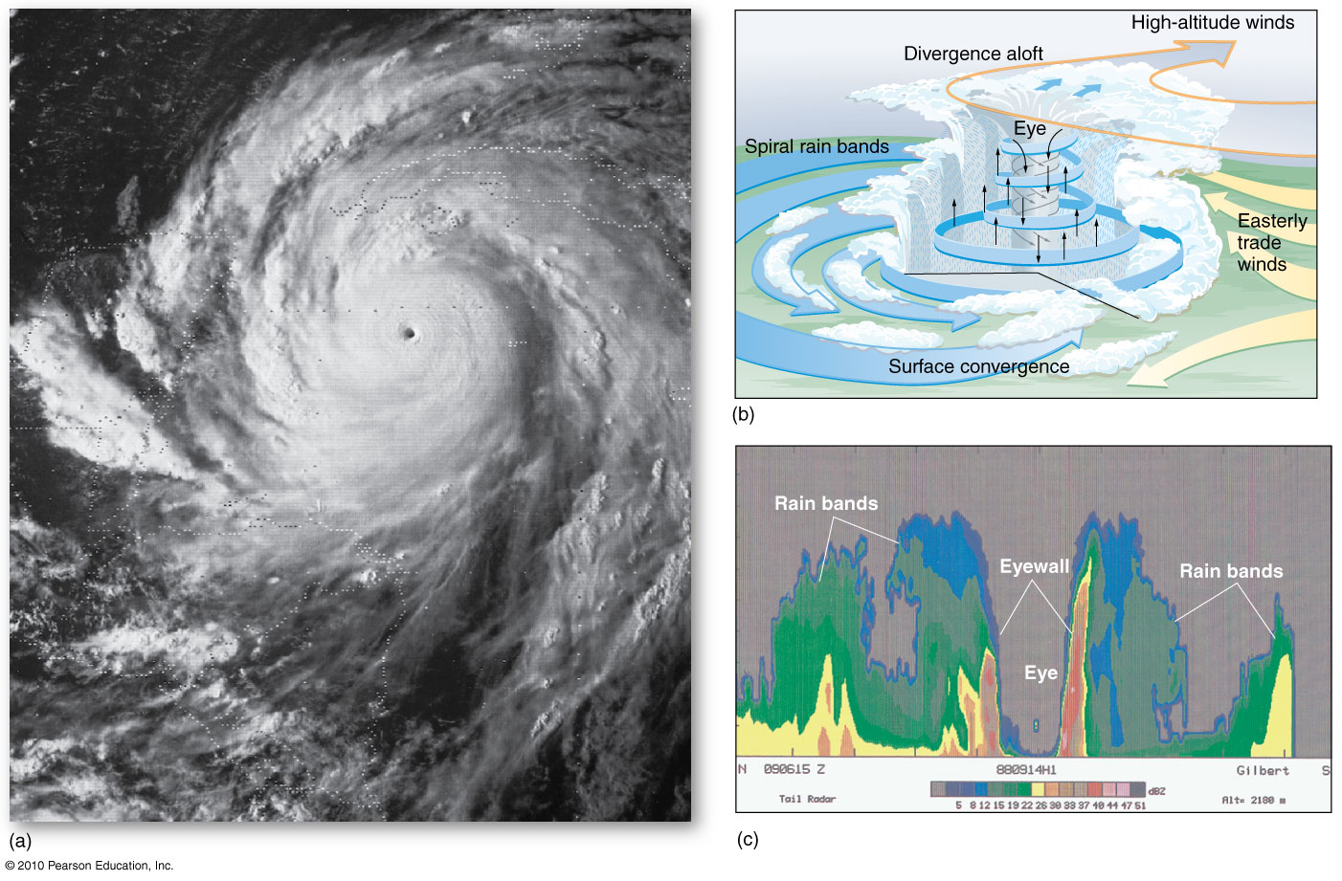
Profile of a Hurricane
Figure 5.41
Christopherson, Elemental Geosystems, Sixth Edition
Copyright © 2010 Pearson Education, Inc.

Slide 72
NEXT LECTURE – CHAPTER 6
END OF LECTURE

